Slide 1
notes_2_6_2023
1/20 之后又做了 63 个控制变量实验！

Slide 2
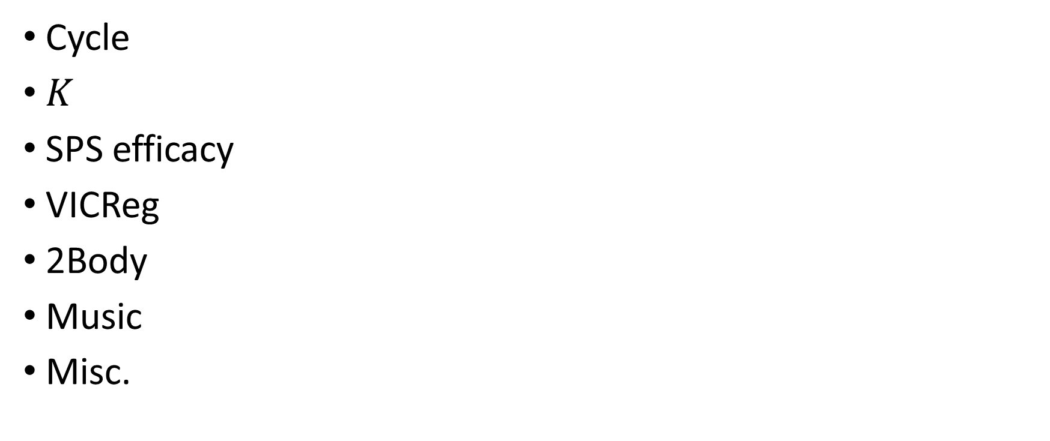
Roadmap
Cycle
$K$
SPS efficacy
VICReg
2Body
Music
Misc.

Slide 3
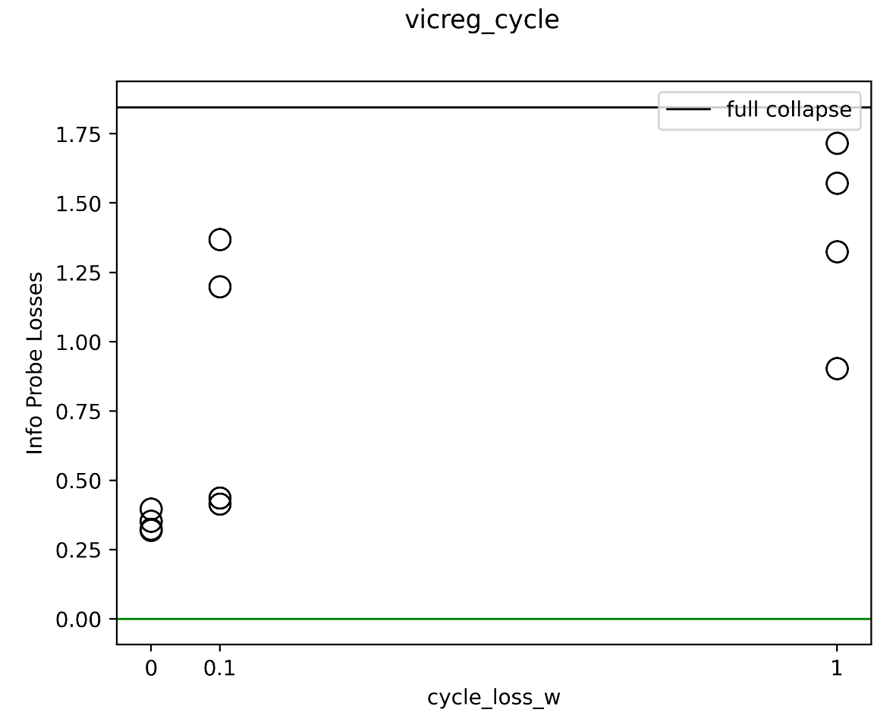
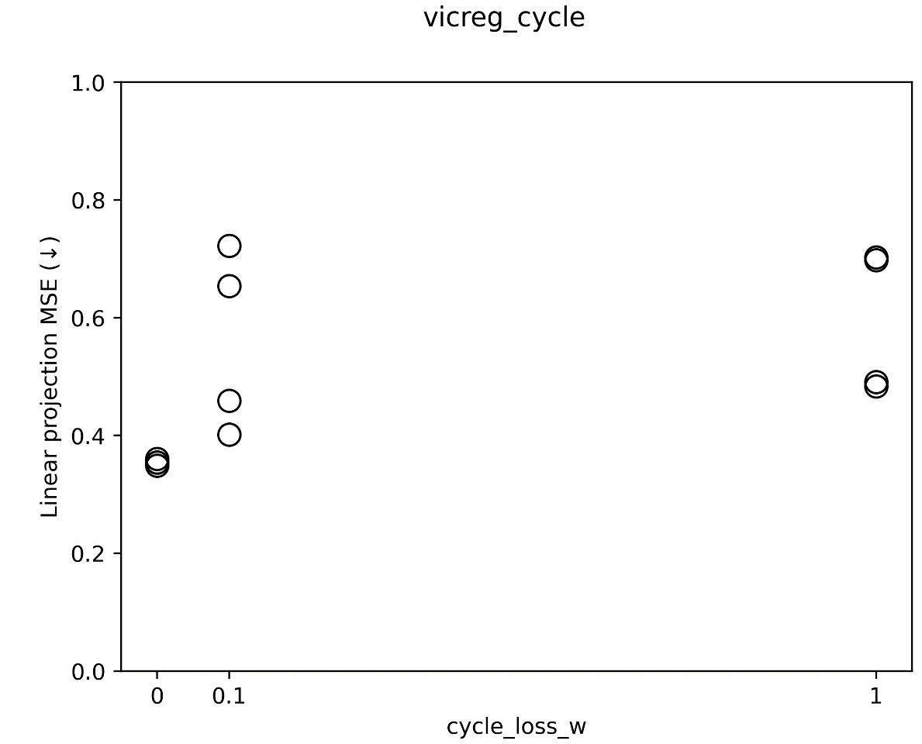
VICReg + cycle consistency (②)
2023_m01_d25@06_07_15_vicreg_cycle
Check evalDecoder: 隐写些啥

Slide 4
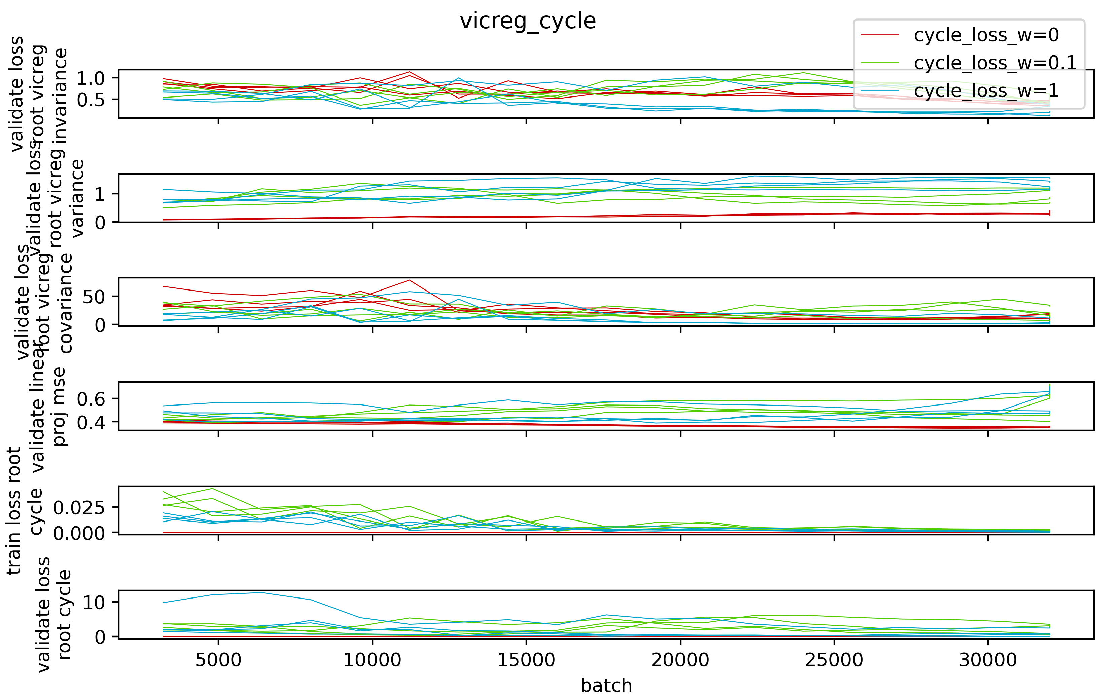

Slide 5
VICReg + cycle consistency (②)
More likely to collapse. Less info content. higher V loss.

Slide 6
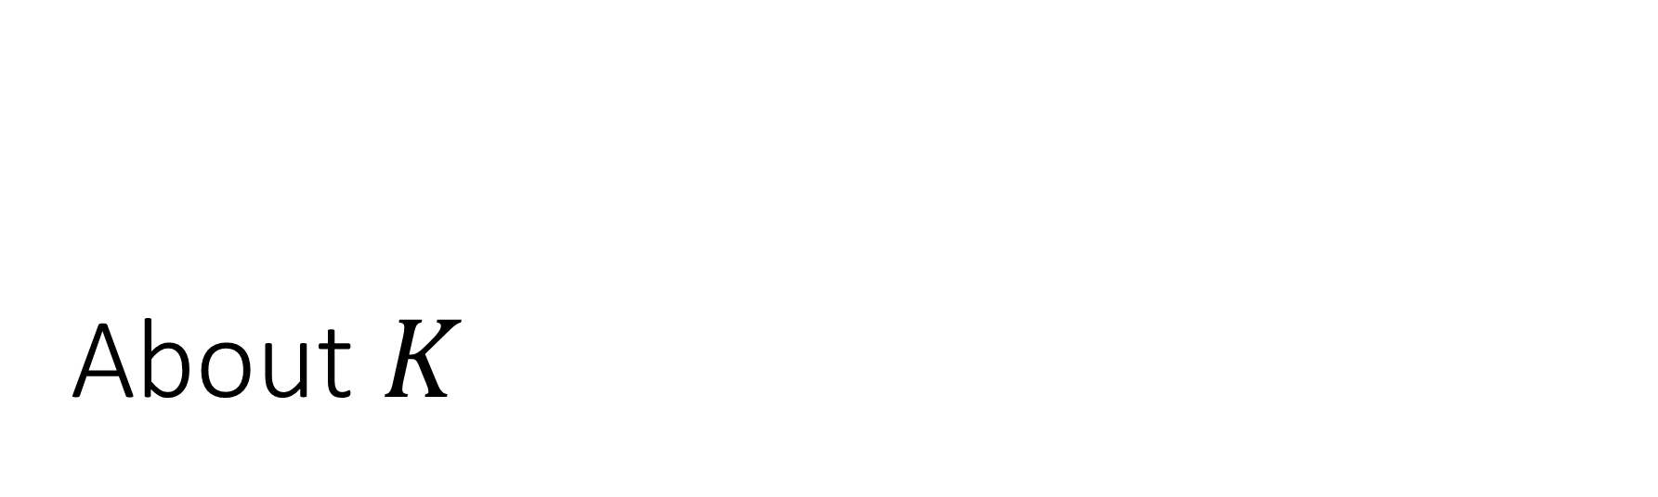
About $K$

Slide 7
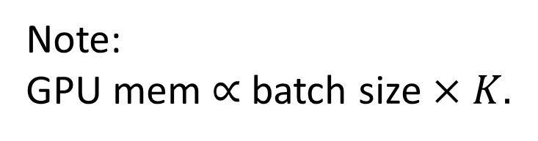
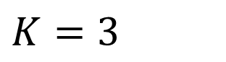
Method used by ICLR23 submission
Dataset
Note: GPU mem $∝$ batch size $×K.$
Aug
$K=3$
Batch size=3

Slide 8
For the past four months, Dan’s been doing this
Dataset
Aug
Batch size

Slide 9
Many alternatives exist…
Dataset
Aug

Slide 10
Many alternatives exist…
Dataset
Aug

Slide 11
Many alternatives exist…
Dataset
minibatch
Aug

Slide 12
Many alternatives exist…
Dataset
Aug
minibatch

Slide 13
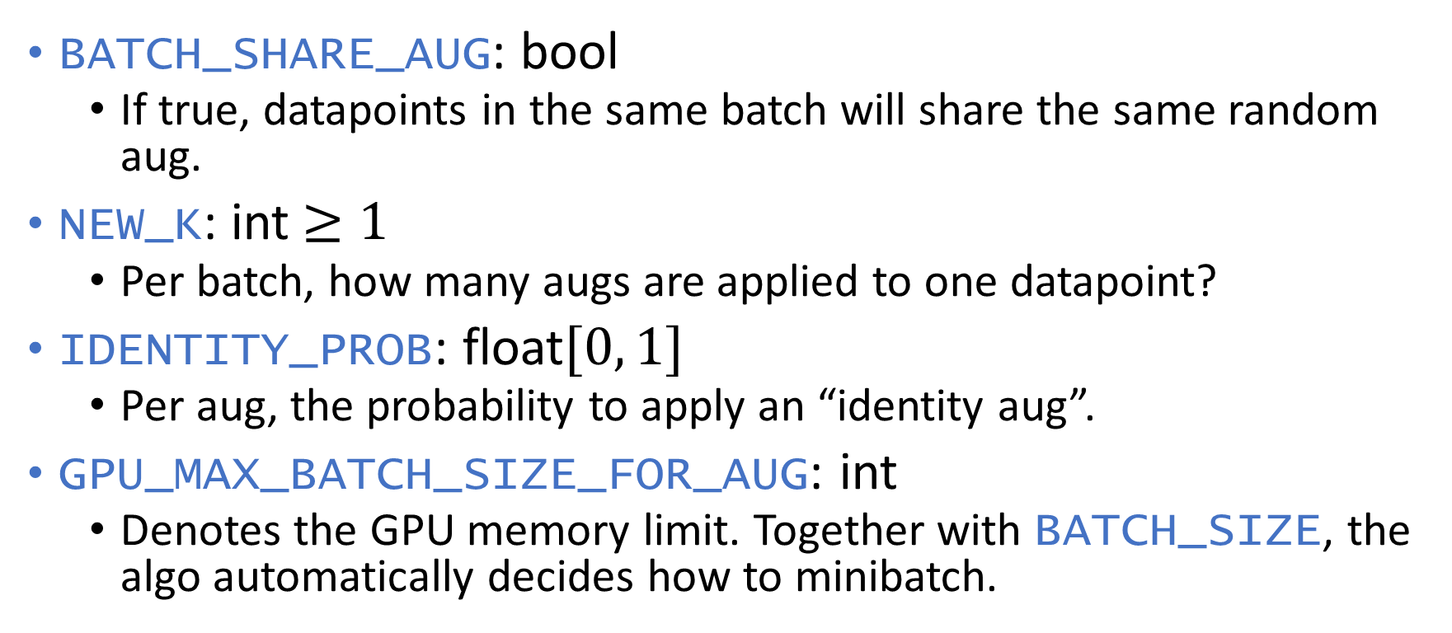
Proposal (其实是先斩后奏)
BATCH_SHARE_AUG: bool
If true, datapoints in the same batch will share the same random aug.
NEW_K: int $≥1$
Per batch, how many augs are applied to one datapoint?
IDENTITY_PROB: float$[0, 1]$
Per aug, the probability to apply an “identity aug”.
GPU_MAX_BATCH_SIZE_FOR_AUG: int
Denotes the GPU memory limit. Together with BATCH_SIZE, the algo automatically decides how to minibatch.

Slide 14
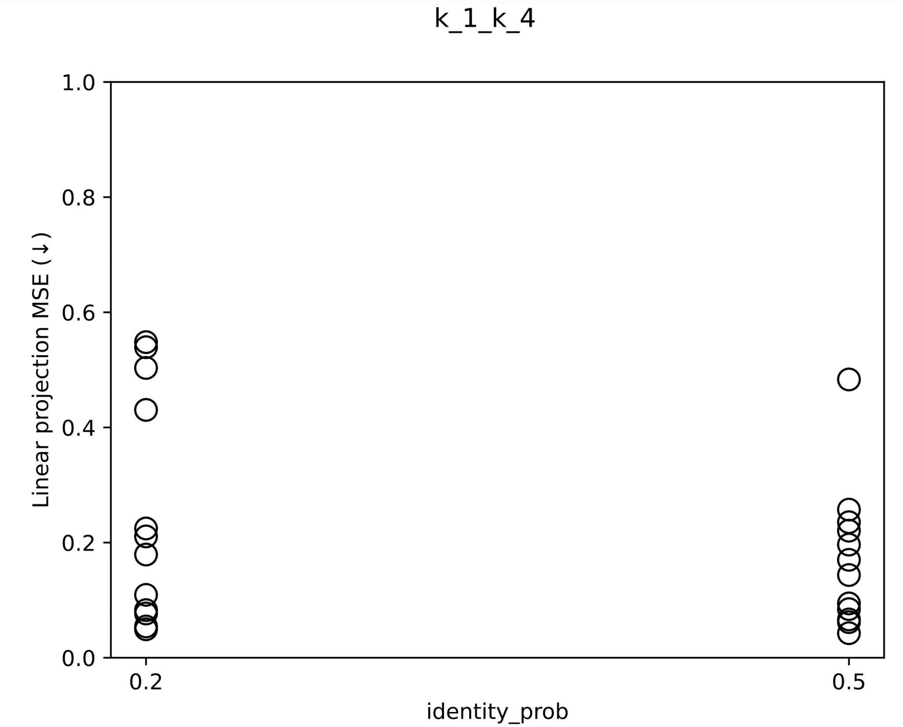
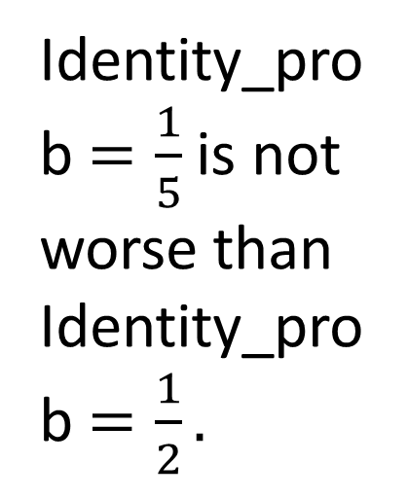
Identity_prob $=\frac{1}{5}$ is not worse than Identity_prob $=\frac{1}{2}.$
Notes:
2023_m01_d22@20_45_36_k_1_k_4

Slide 15
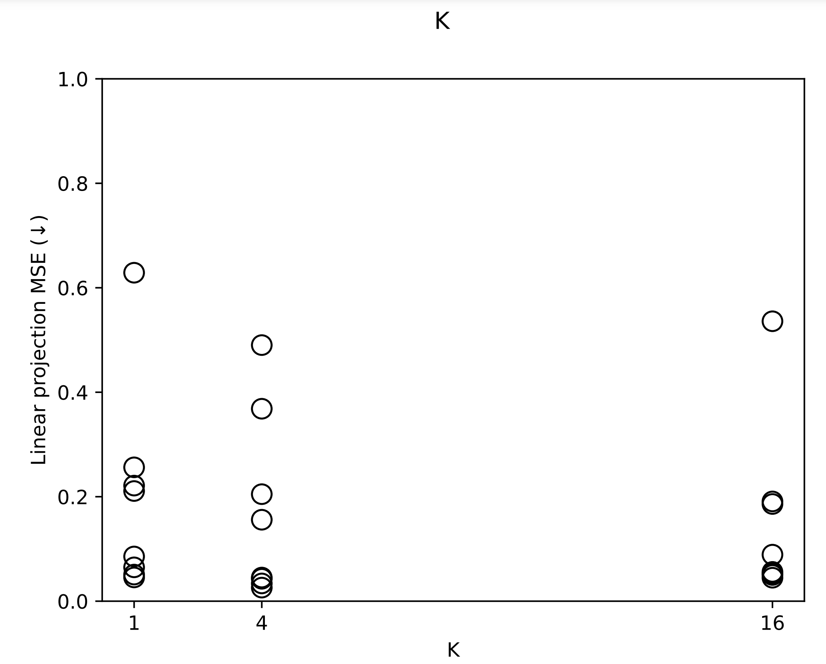
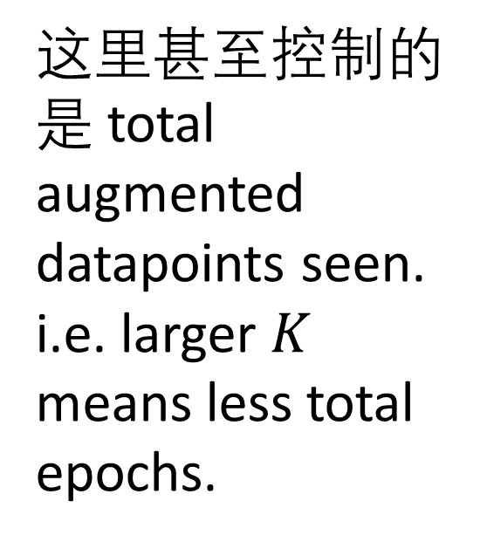
(new)
这里甚至控制的是 total augmented datapoints seen.
i.e. larger $K$ means less total epochs.
(new)
Notes:
2023_m01_d24@19_40_53_K

Slide 16
Question
What should BATCH_SHARE_AUG be?

Slide 17
SPS effectiveness on bouncing ball

Slide 18
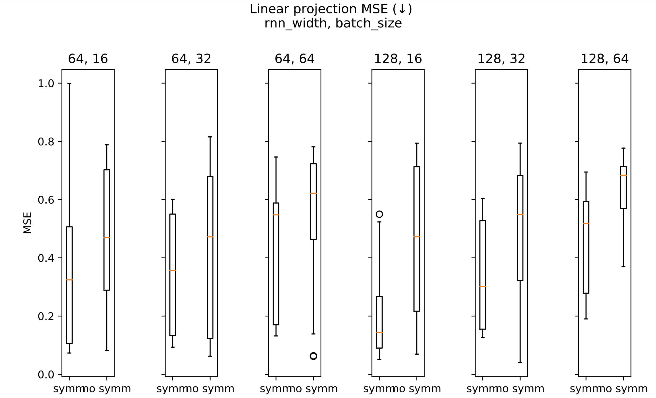
Notes:
2023_m01_d04@01_22_50_sps

Slide 19
SPS effectiveness on bouncing ball
Is SPS effective?
yes.
Is the baseline strong enough?
no.
SPS's effect is more pronounced as RNN size increases.
Note: even when comparing RNN(64) VS RNN(128)+symm, symm still wins.
SPS allows you to over-parametrize by at least 4x # of parameters.

Slide 20
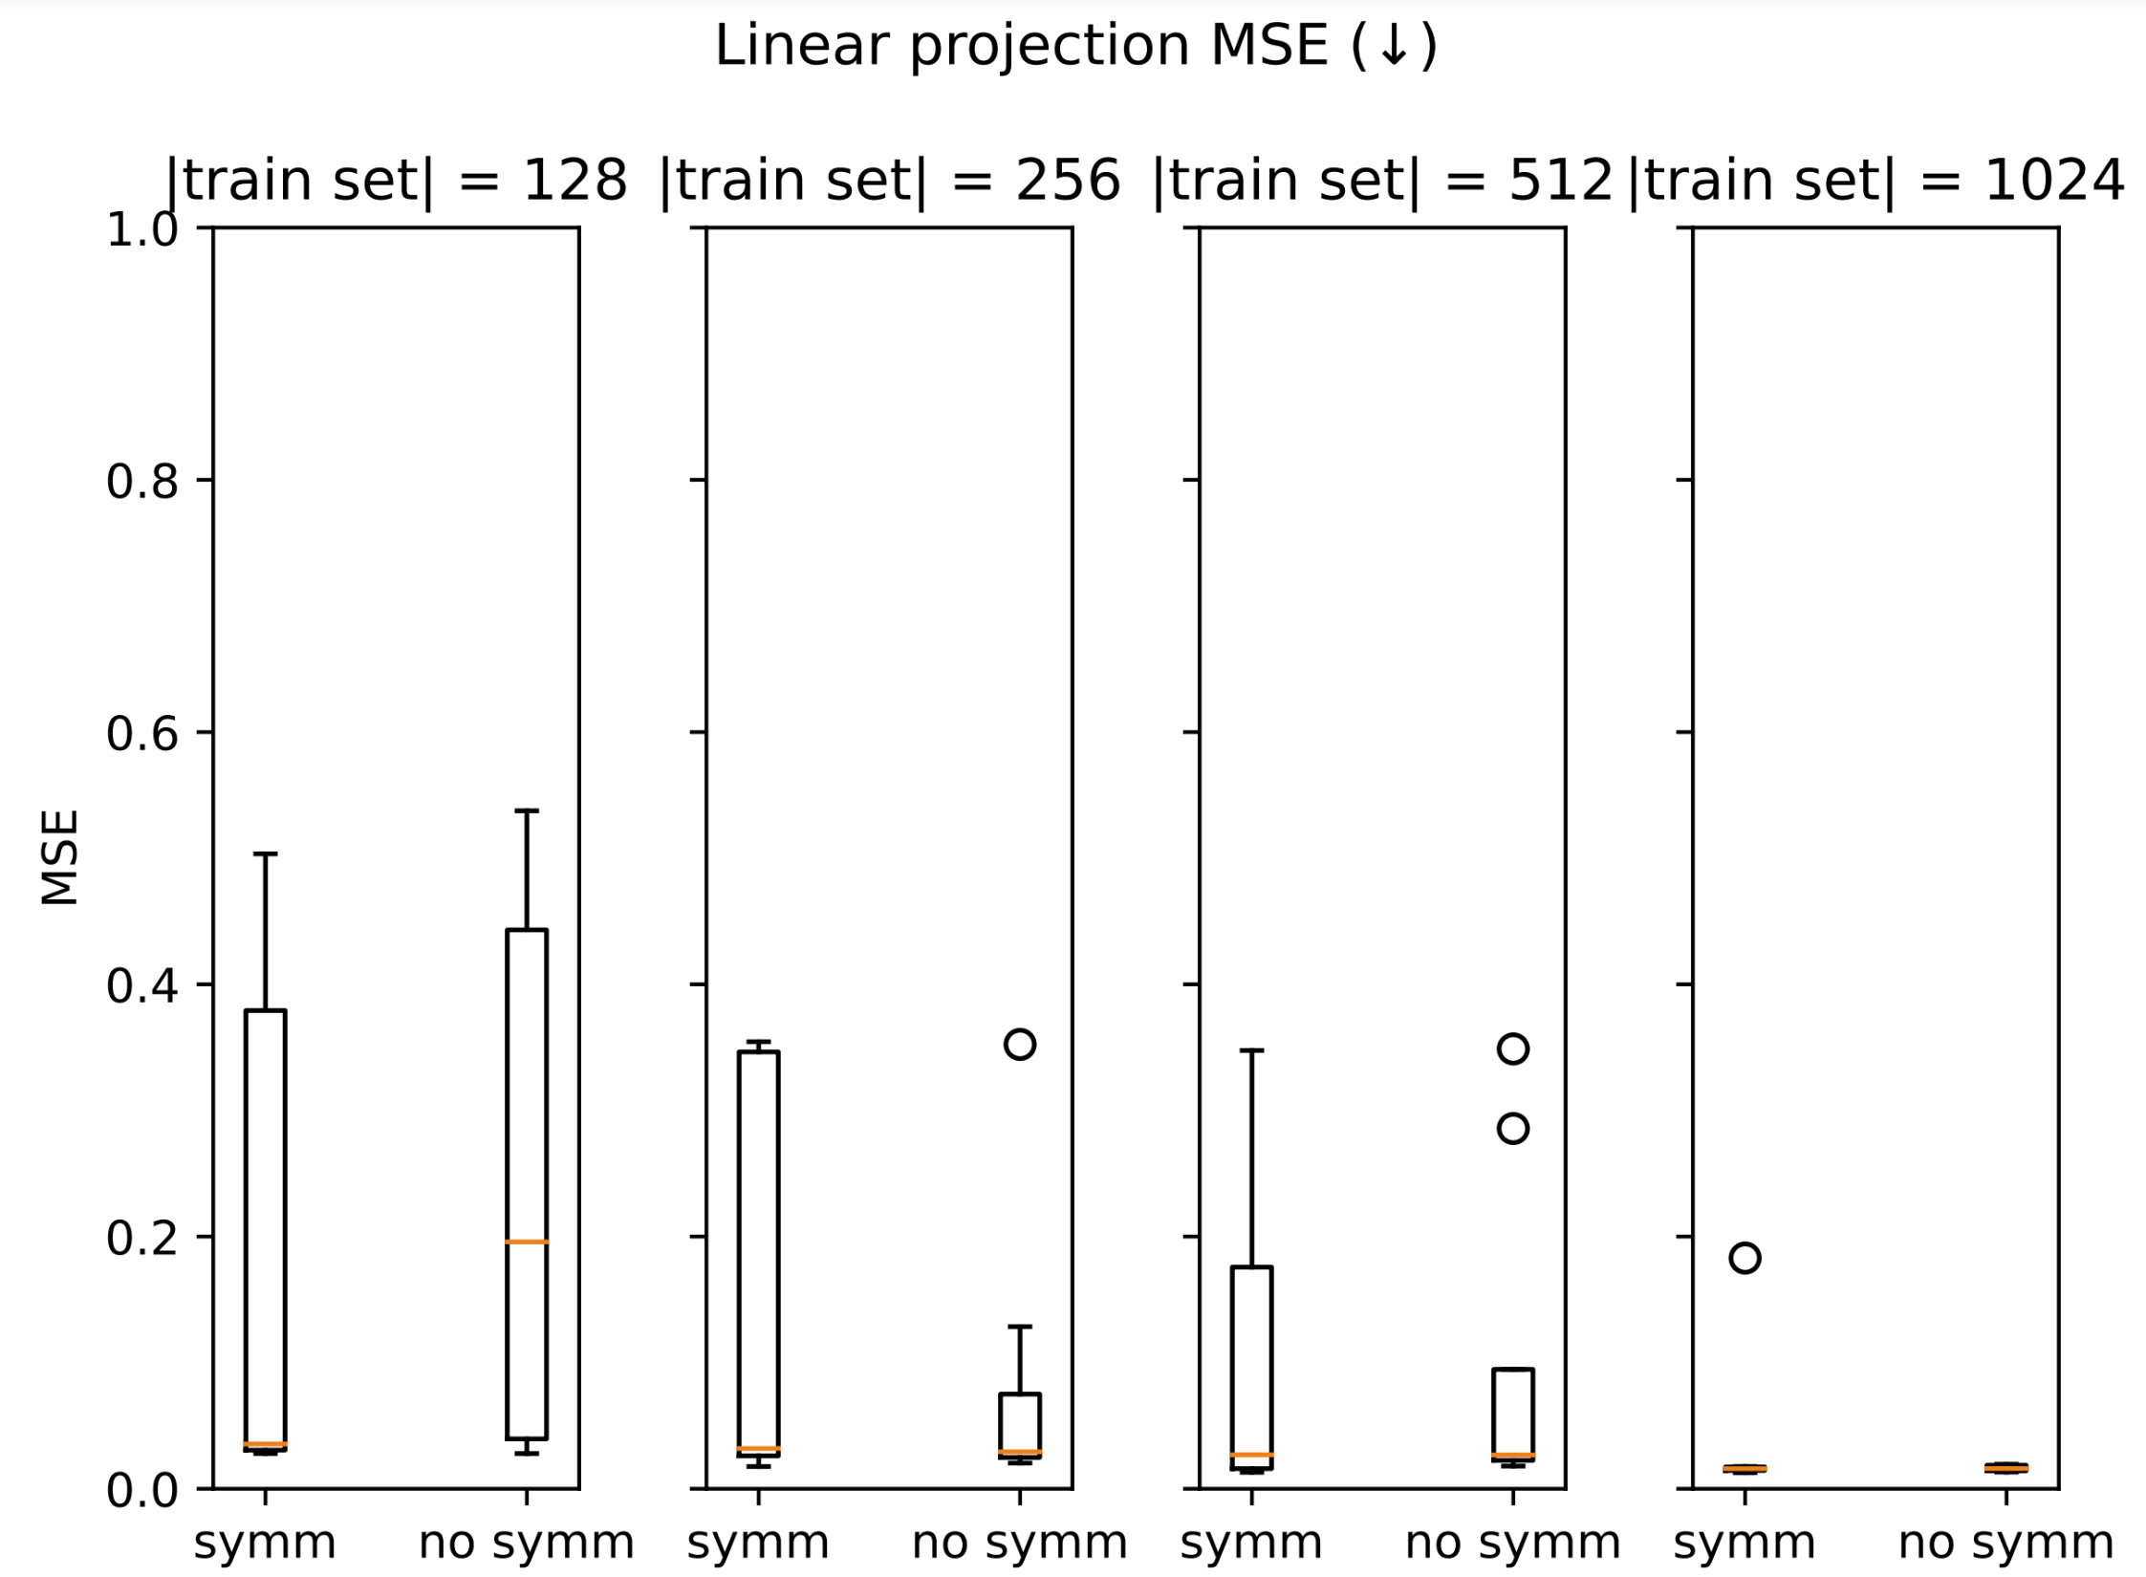
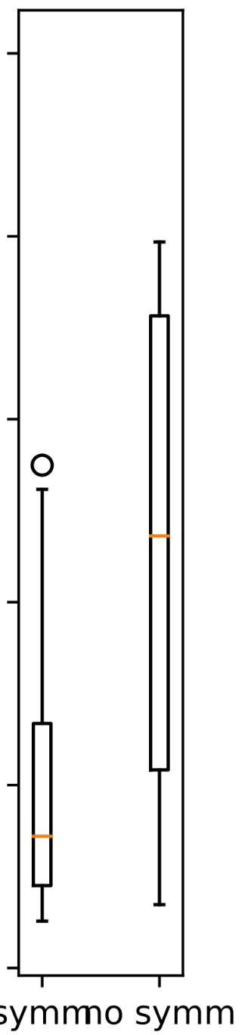
=64

Slide 21
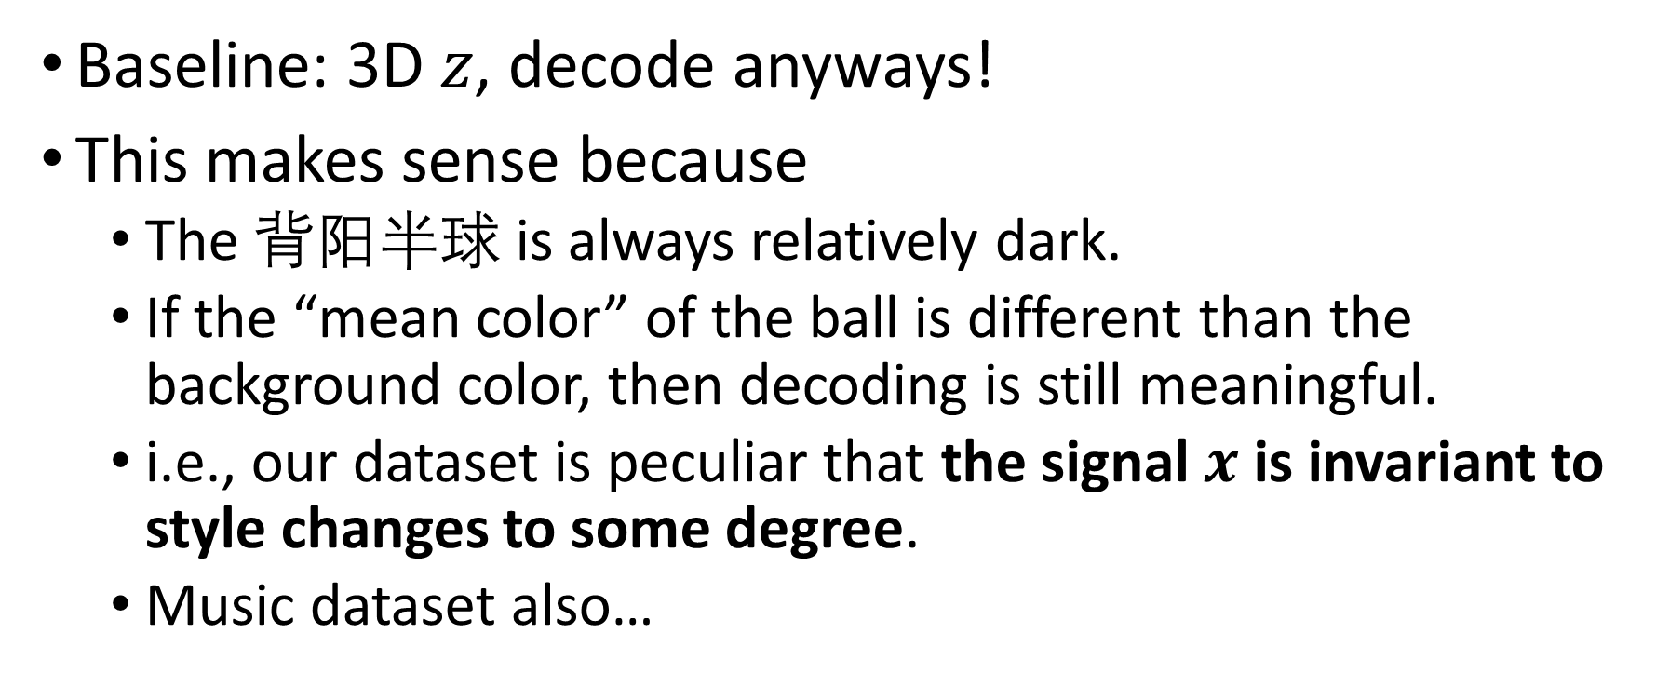
Bouncing ball with flashing colors
Baseline: 3D $z$, decode anyways!
This makes sense because
The 背阳半球 is always relatively dark.
If the “mean color” of the ball is different than the background color, then decoding is still meaningful.
i.e., our dataset is peculiar that the signal $x$ is invariant to style changes to some degree.
Music dataset also…

Slide 22
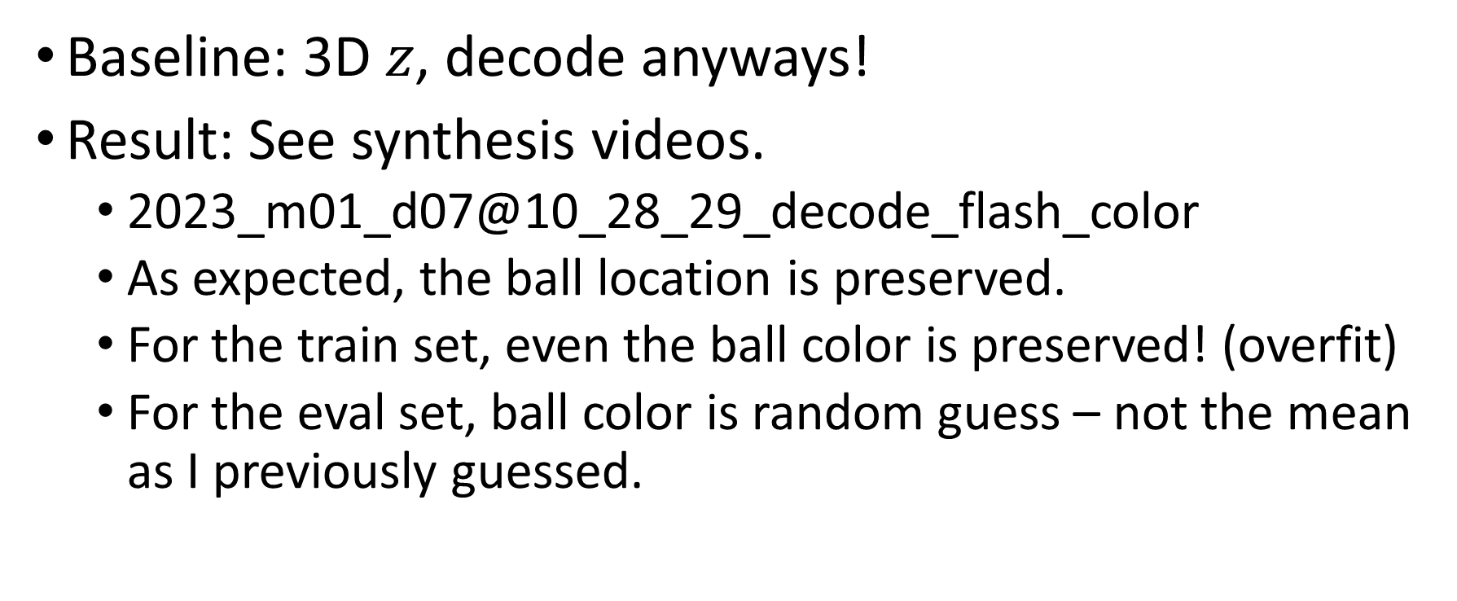
Bouncing ball with flashing colors
Baseline: 3D $z$, decode anyways!
Result: See synthesis videos.
2023_m01_d07@10_28_29_decode_flash_color
As expected, the ball location is preserved.
For the train set, even the ball color is preserved! (overfit)
For the eval set, ball color is random guess – not the mean as I previously guessed.

Slide 23
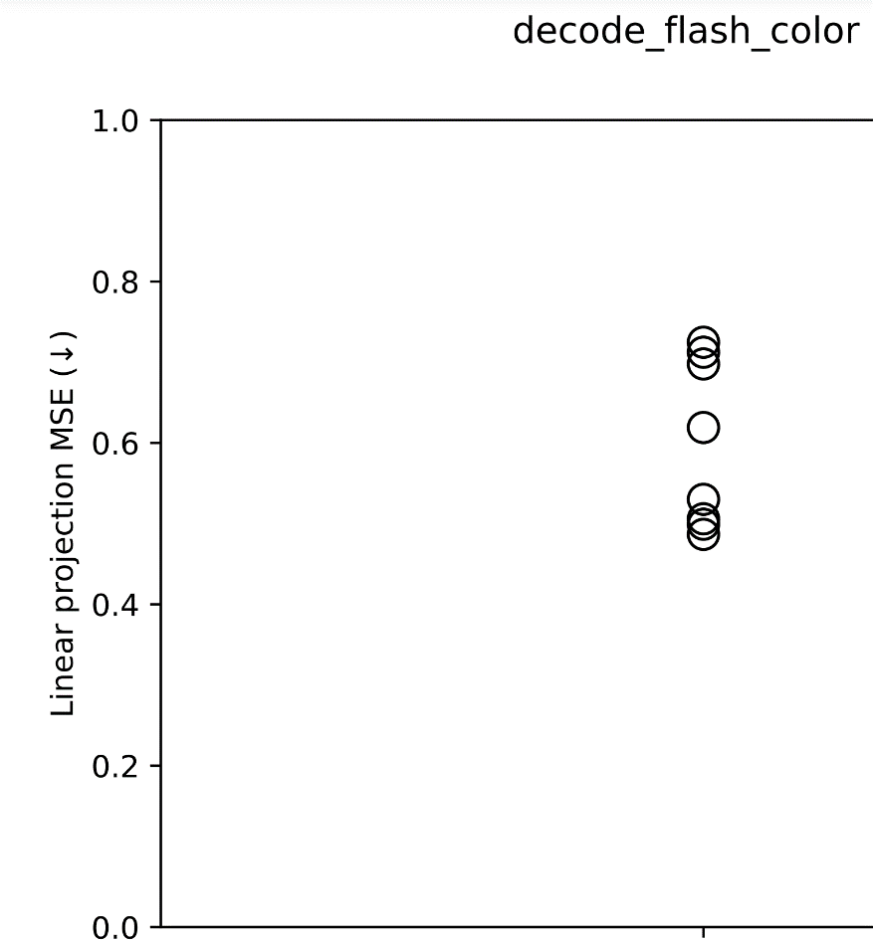
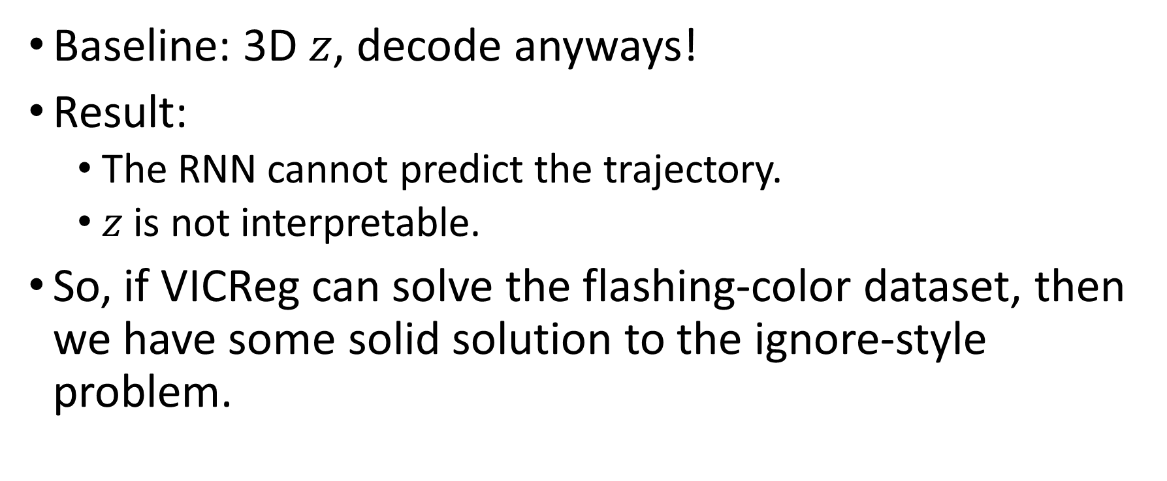
Bouncing ball with flashing colors
Baseline: 3D $z$, decode anyways!
Result:
The RNN cannot predict the trajectory.
$z$ is not interpretable.
So, if VICReg can solve the flashing-color dataset, then we have some solid solution to the ignore-style problem.

Slide 24
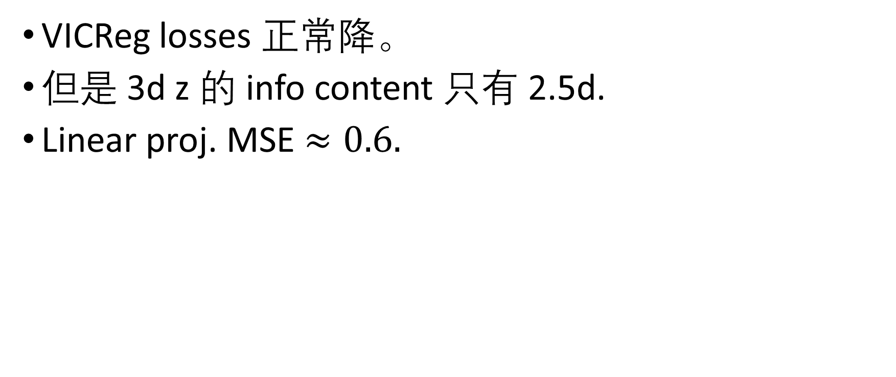
VICReg 初步调参取得的结果
VICReg losses 正常降。
但是 3d z 的 info content 只有 2.5d.
Linear proj. MSE $≈0.6.$

Slide 25
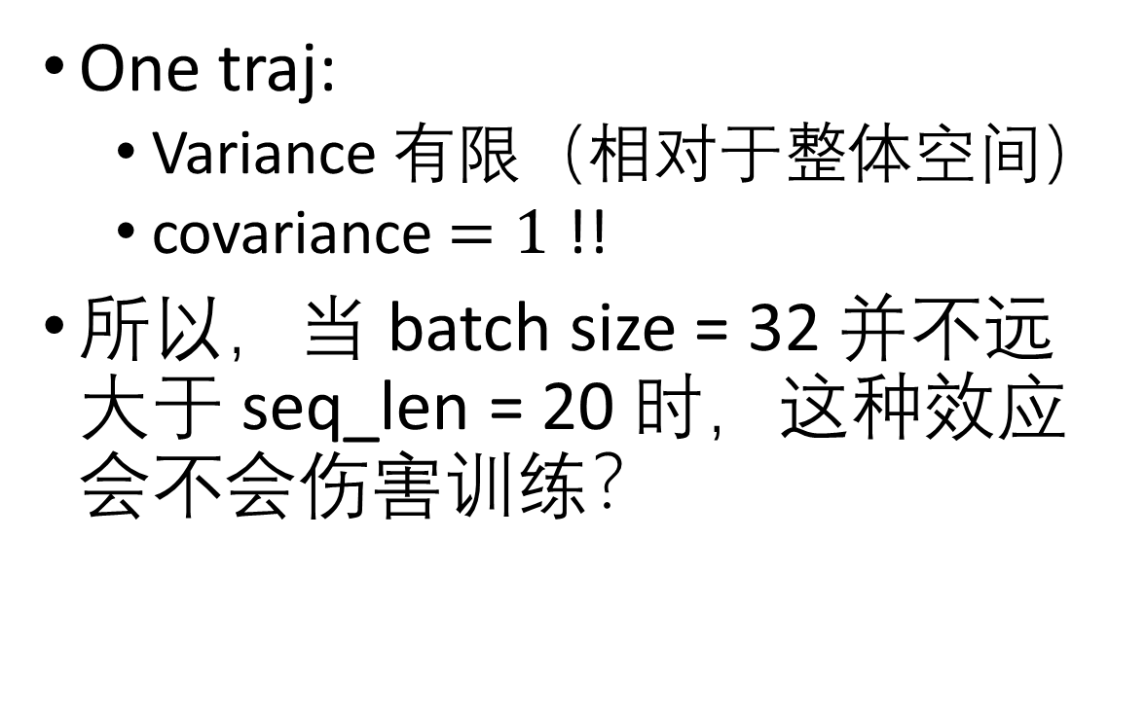
Problem: VICReg’s assumptions don’t fit?
One traj:
Variance 有限（相对于整体空间）
covariance$=1$ !!
所以，当 batch size = 32 并不远大于 seq_len = 20 时，这种效应会不会伤害训练？

Slide 26
Solution: cross-trajectory VICReg
Only apply the variance and covariance losses on cross-trajectory video frames.
(Turned out to be GPU-efficient, luckily.)
One batch:
One traj
One traj
One traj

Slide 27
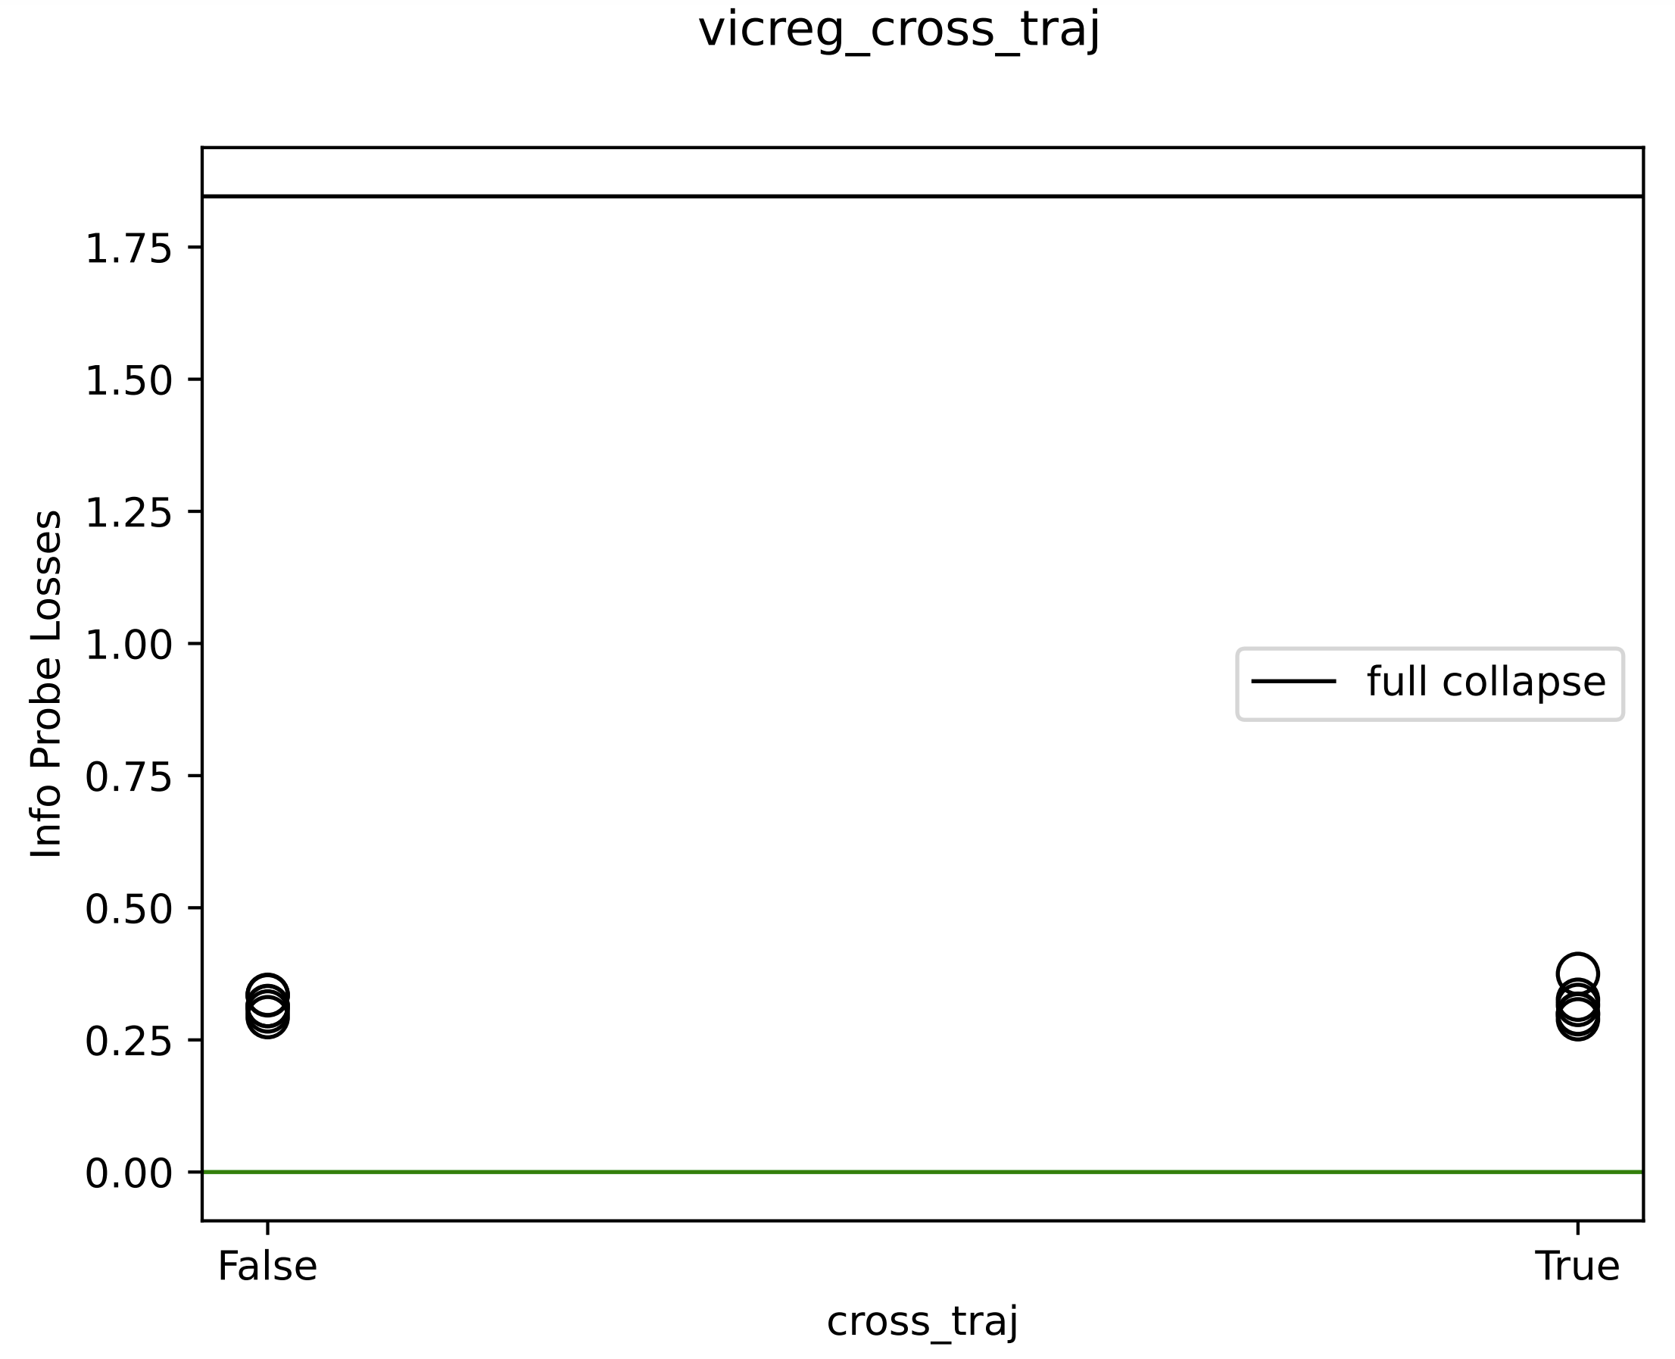
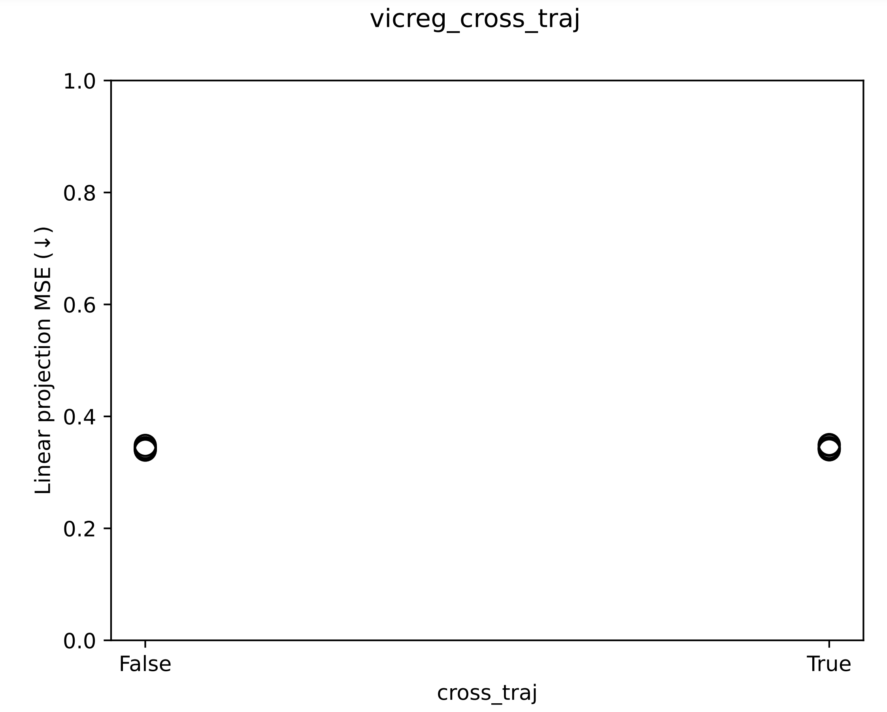
Cross-trajectory VICReg
Experiment results: 丝毫没用
Notes:
2023_m01_d26@06_31_58_vicreg_cross_traj

Slide 28
Cross-trajectory VICReg
(其实光从数学就可以推出 cross-traj VICReg 和 normal VICReg 是几乎等价的)

Slide 29
SPS-decode fulfills VICReg
SPS-decode 训完之后，VIC 三 loss 都低，info content 完美。
SPS-VICReg 训完之后，VIC 三 loss 稍高，尤其是 invariance loss (i.e., image prediction). Info content 只有 2.5d.

Slide 30

VICReg 1Ball, 2D $z$
Motivation:
Maybe VICReg keeps failing because in SPS-decode the vertical height is regularized by the decoder losses.

Slide 31
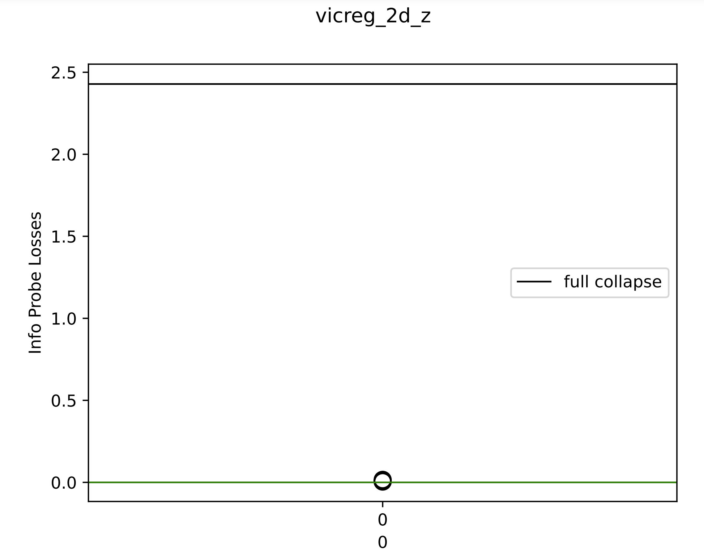
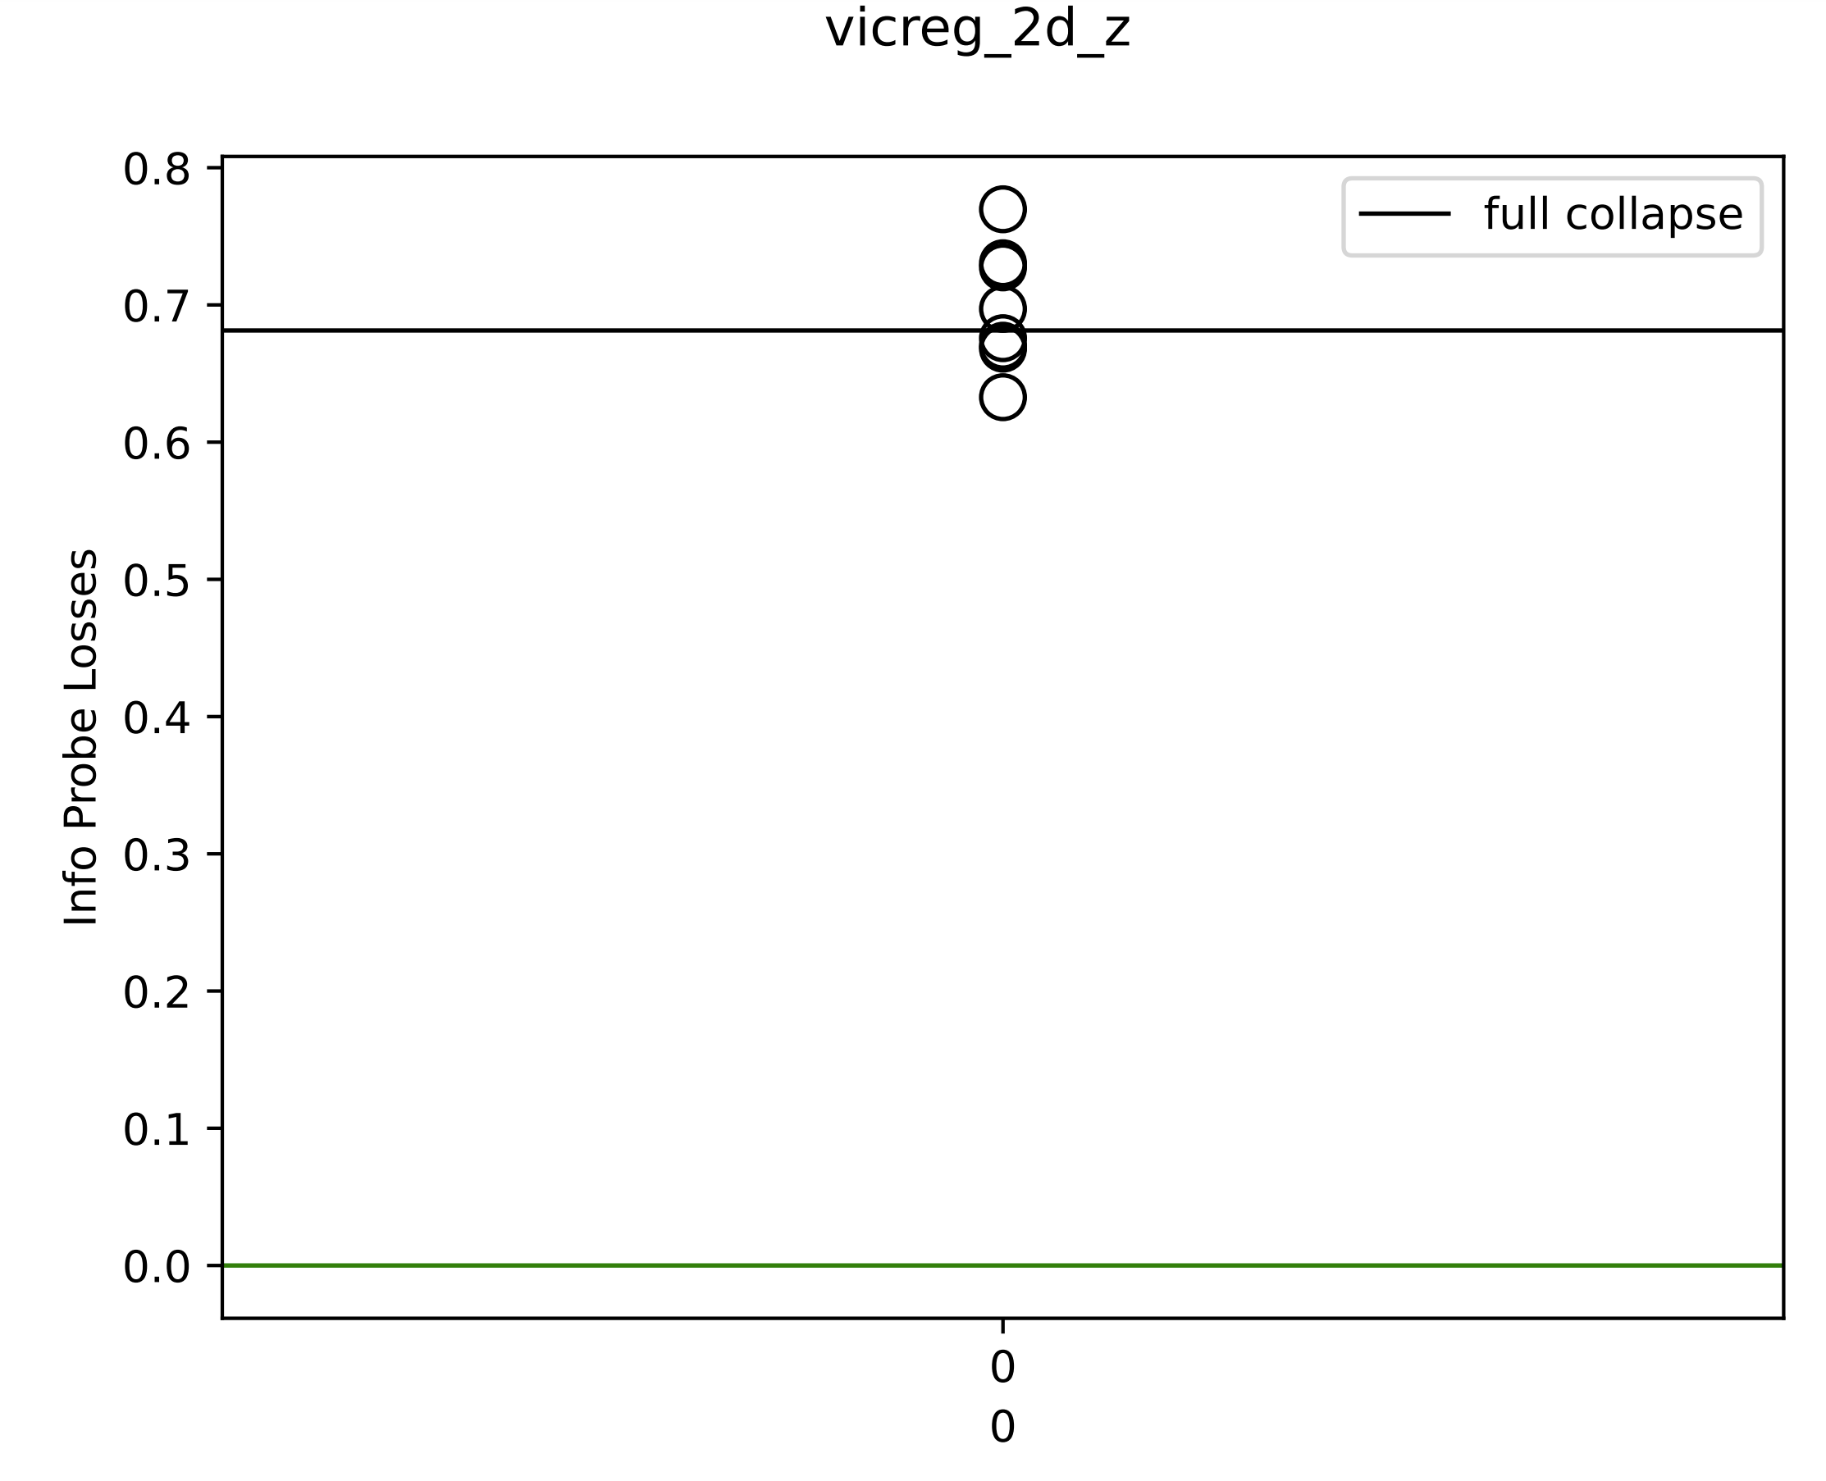
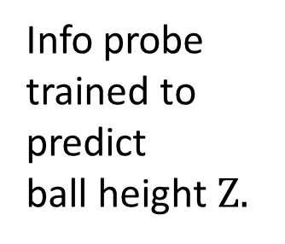
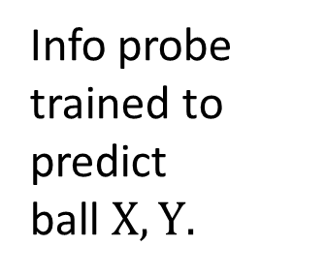
Info probe trained to predict ball $X, Y.$
Info probe trained to predict ball height $Z.$
Notes:
2023_m02_d01@07_53_02_vicreg_2d_z

Slide 32
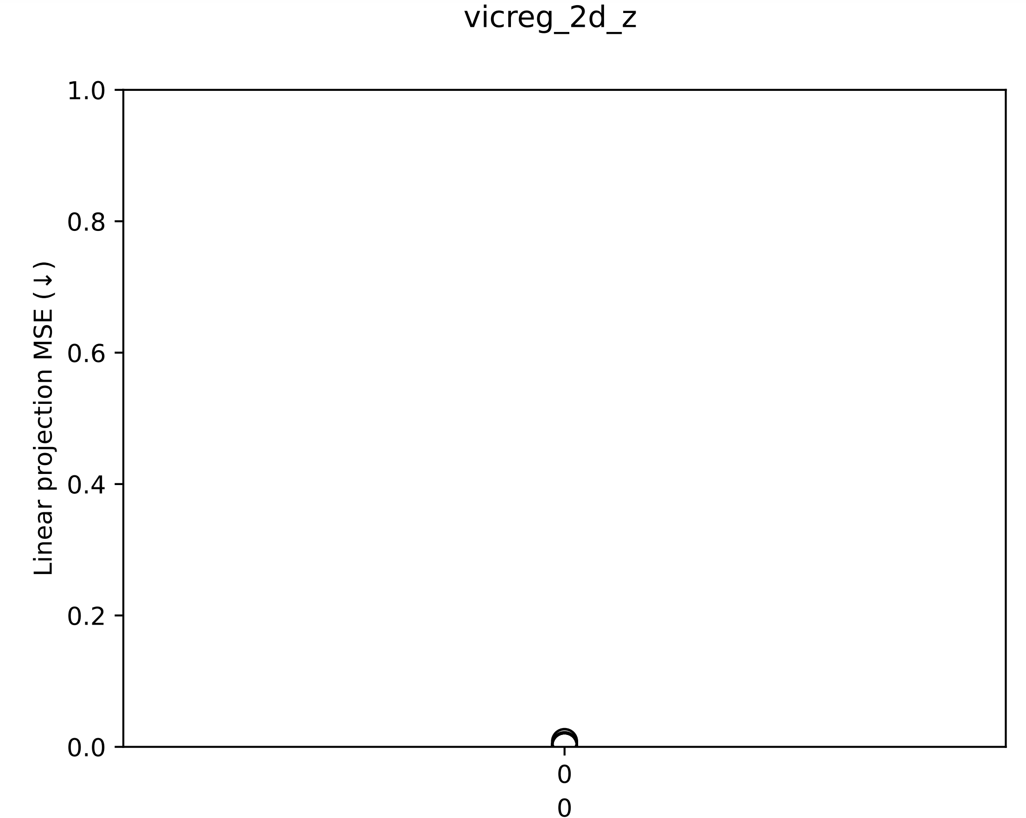
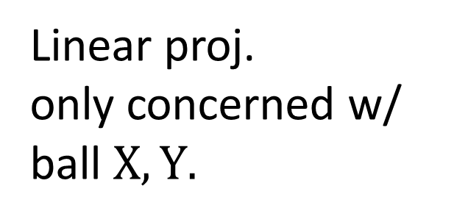
Linear proj. only concerned w/ ball $X, Y.$

Slide 33
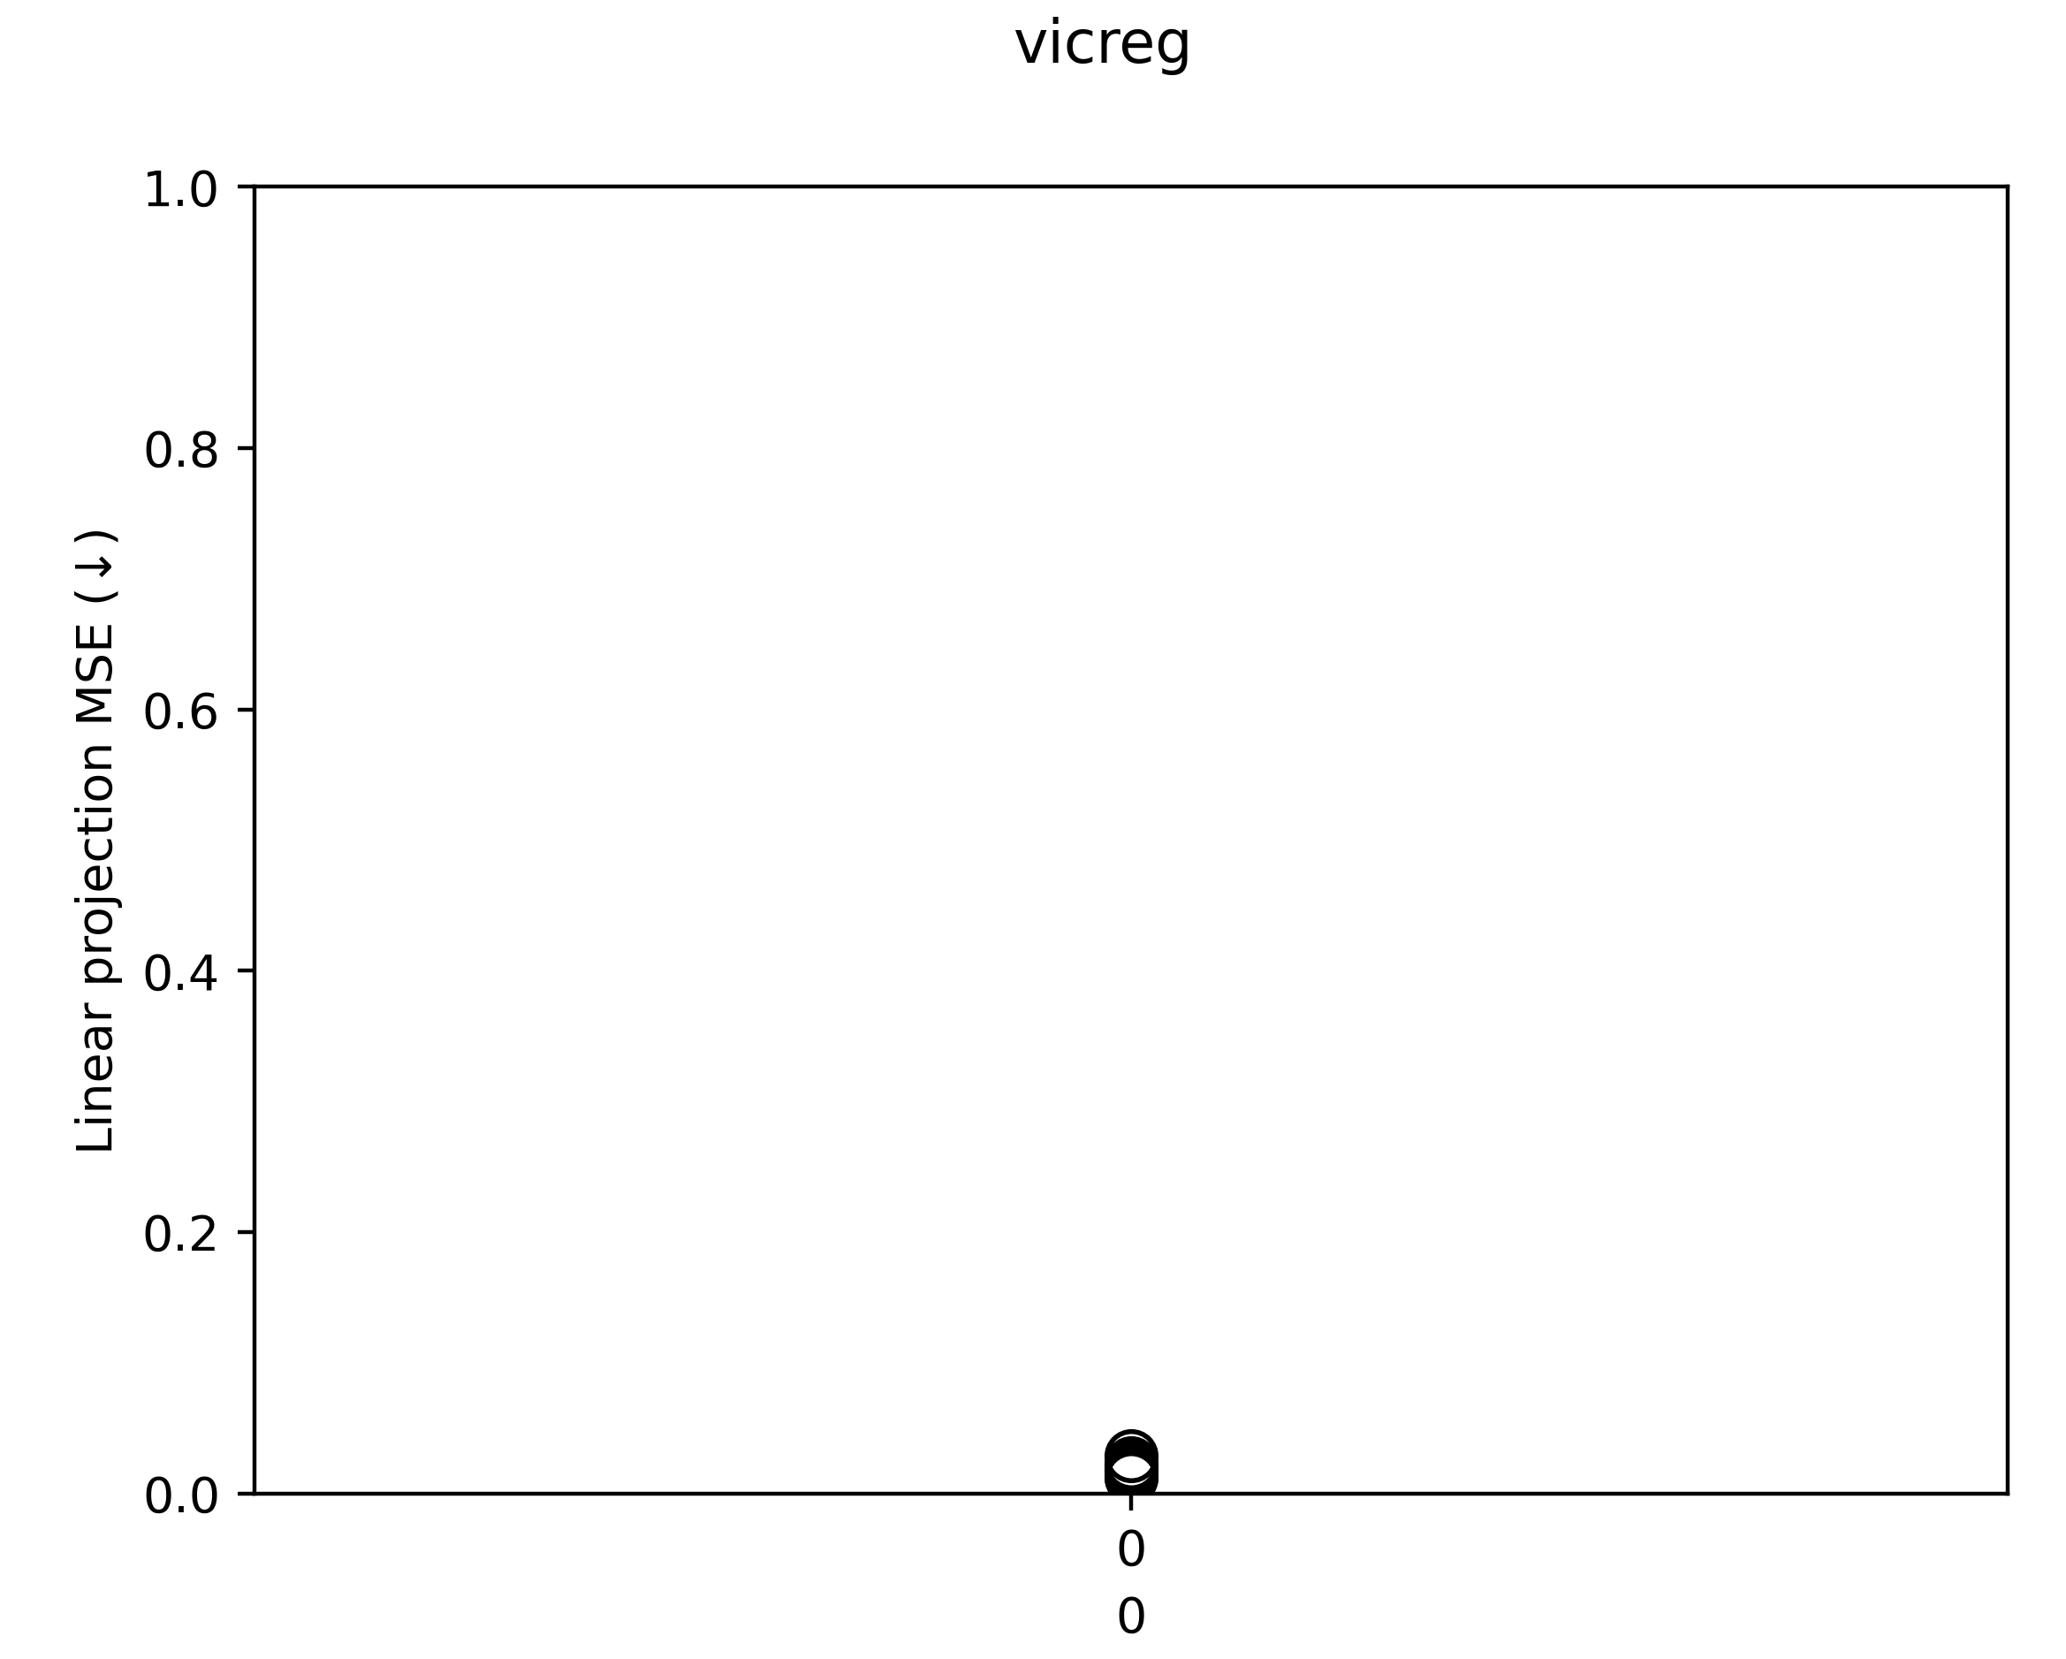
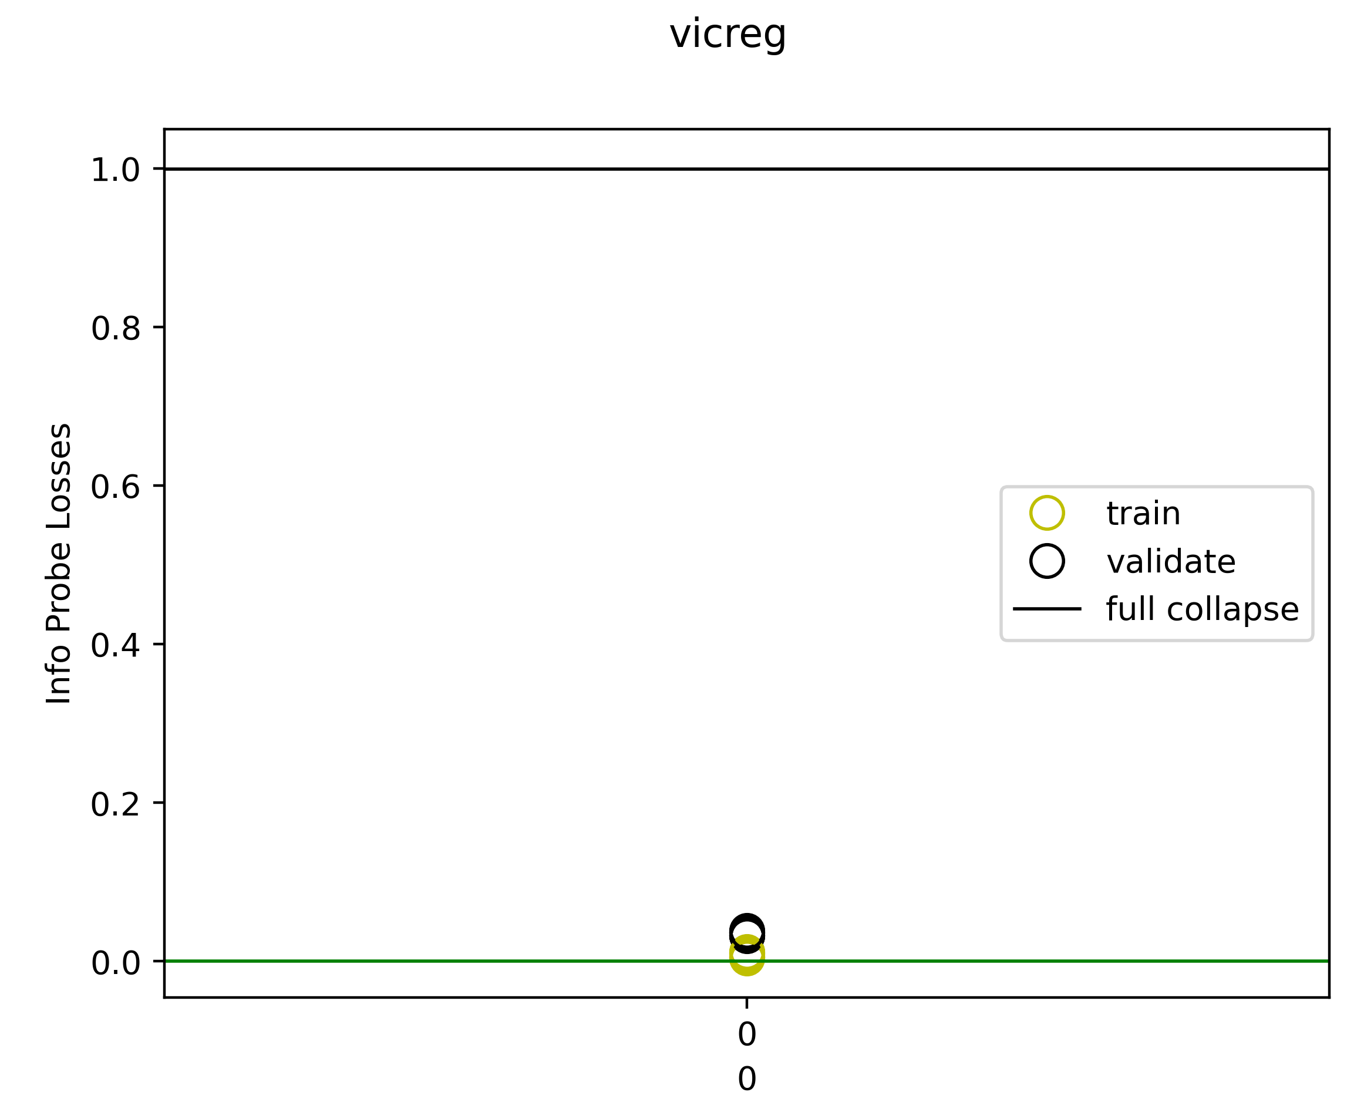
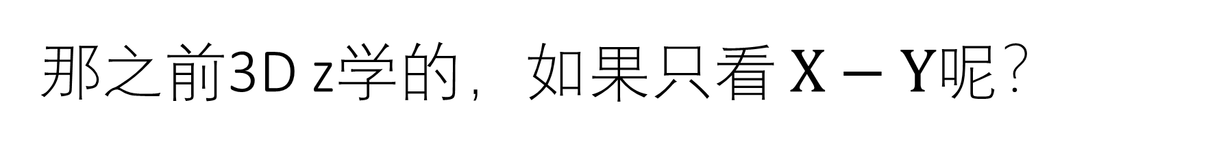
那之前3D z学的，如果只看 $X−Y$呢？

Slide 34
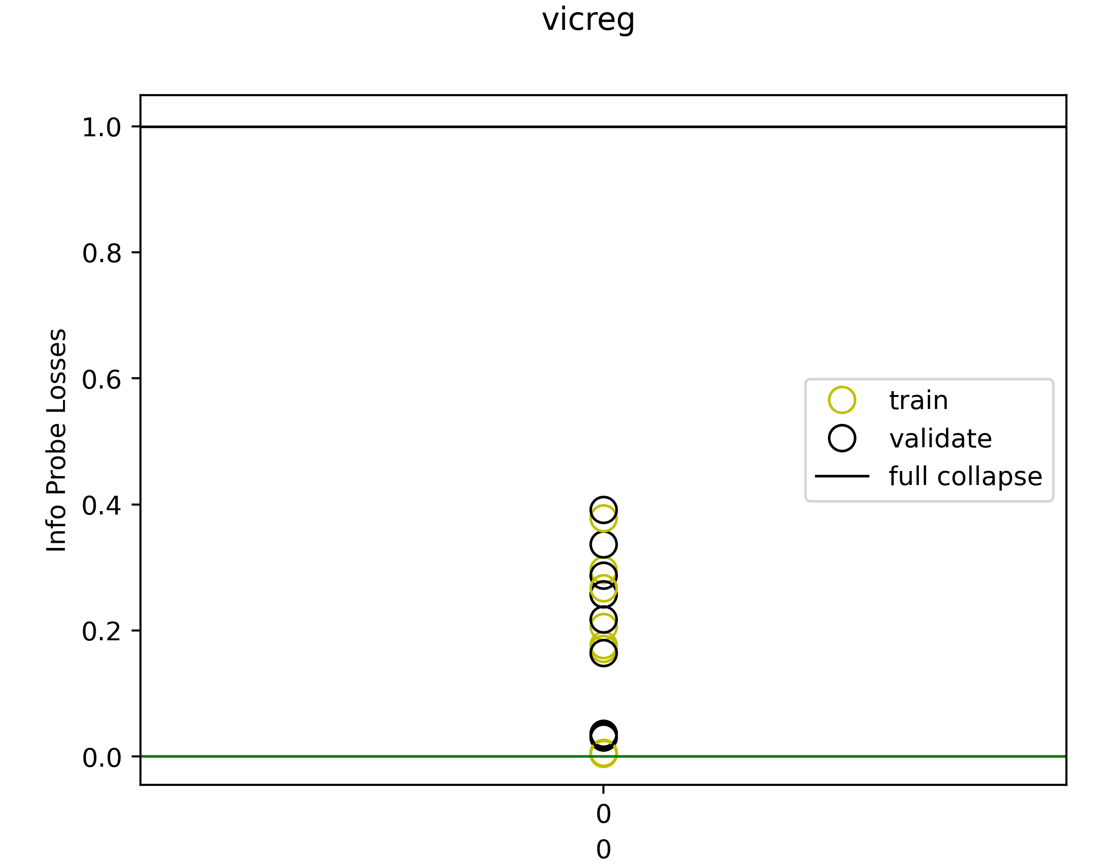
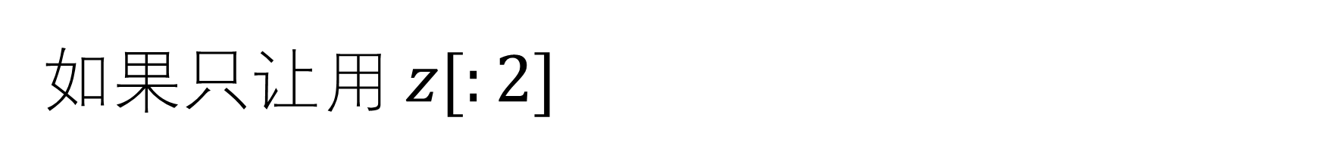
如果只让用 $z[:2]$
As expected, it likes to use the unregularized dimension whenever it can.

Slide 35
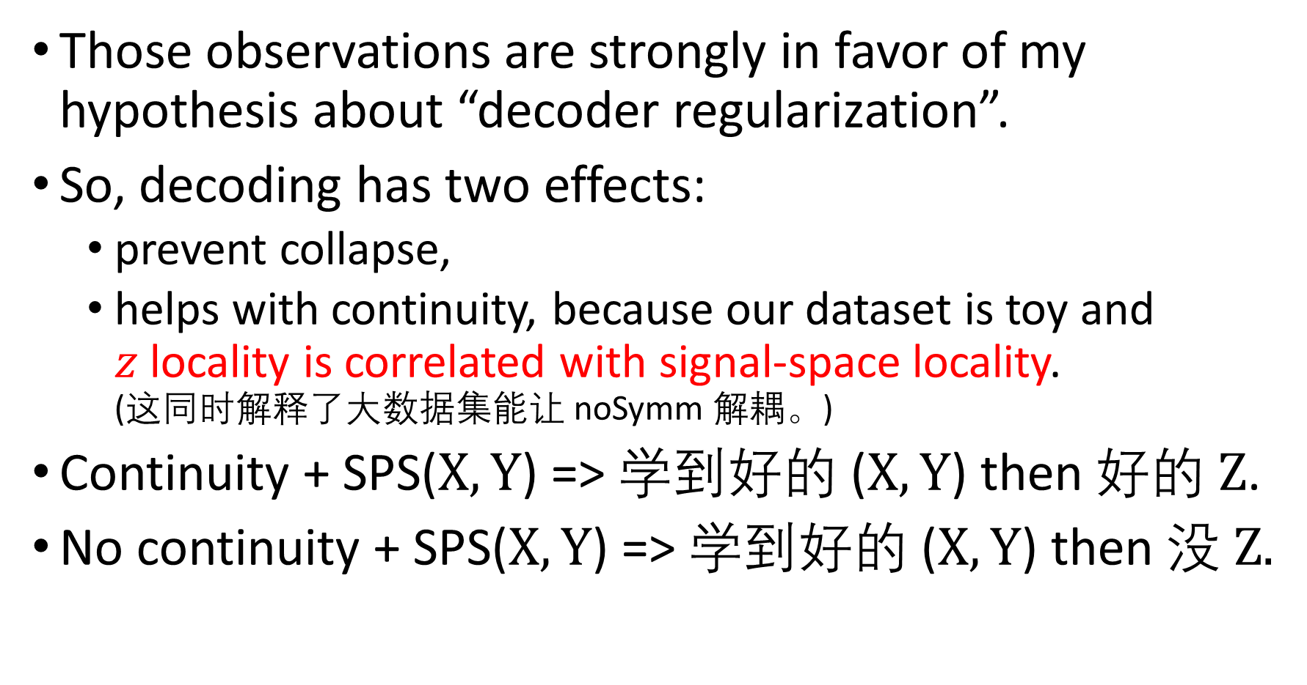
Those observations are strongly in favor of my hypothesis about “decoder regularization”.
So, decoding has two effects:
prevent collapse,
helps with continuity, because our dataset is toy and $z$ locality is correlated with signal-space locality. (这同时解释了大数据集能让 noSymm 解耦。)
Continuity + SPS($X,Y$) => 学到好的 ($X,Y$) then 好的 $Z$.
No continuity + SPS($X,Y$) => 学到好的 ($X,Y$) then 没 $Z.$

Slide 36
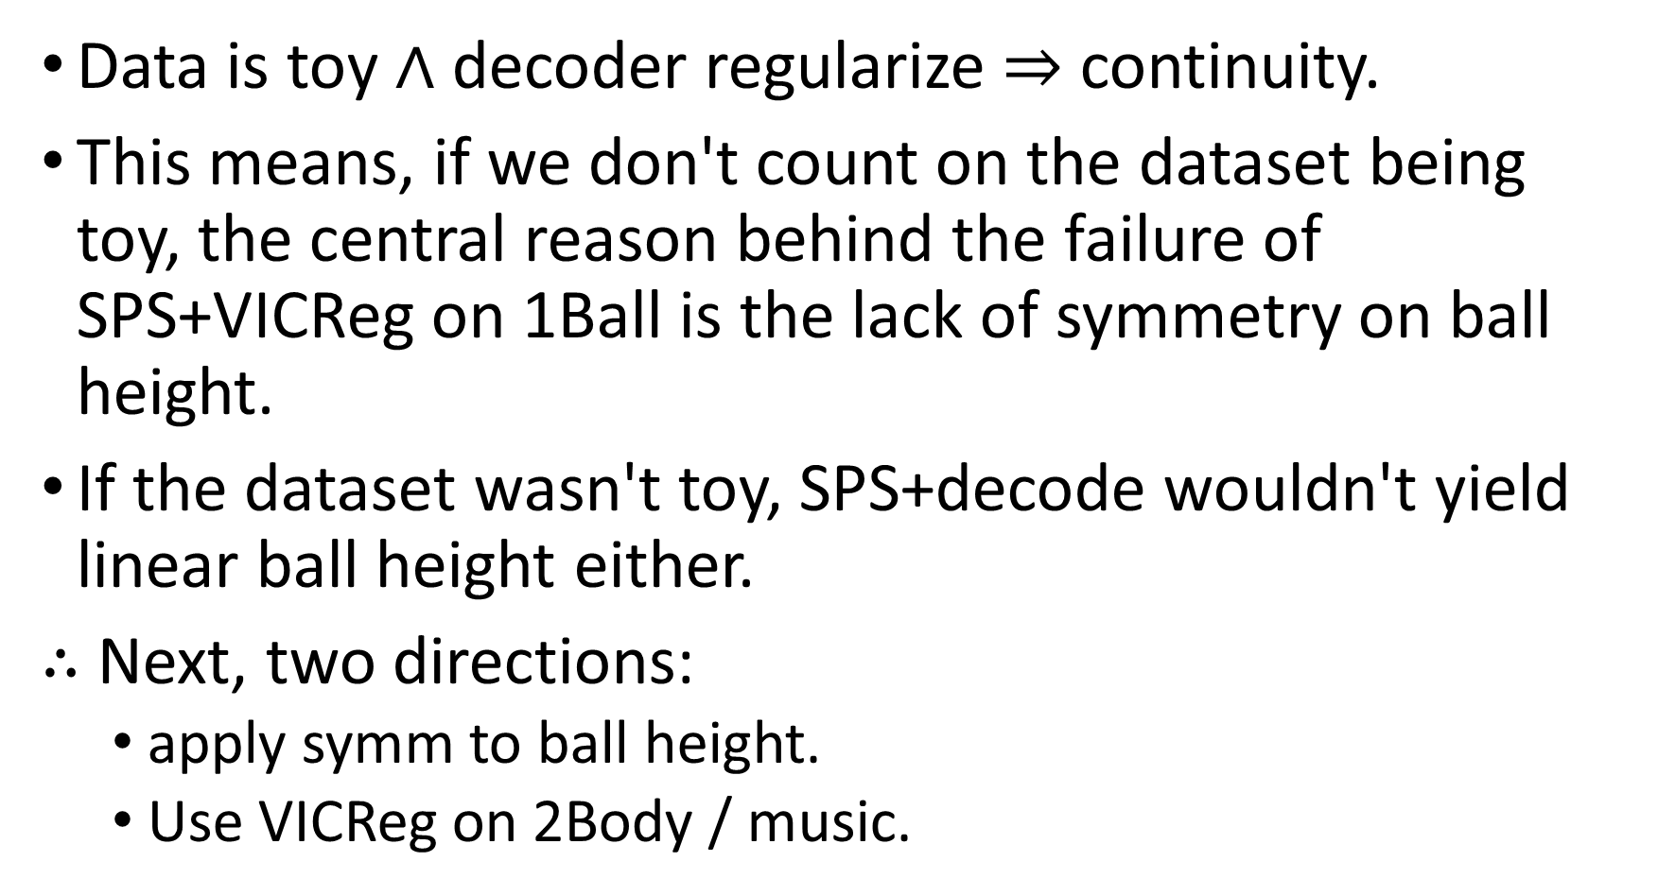
Data is toy $∧$ decoder regularize $⇒$ continuity.
This means, if we don't count on the dataset being toy, the central reason behind the failure of SPS+VICReg on 1Ball is the lack of symmetry on ball height.
If the dataset wasn't toy, SPS+decode wouldn't yield linear ball height either.
$∴$ Next, two directions:
apply symm to ball height.
Use VICReg on 2Body / music.

Slide 37
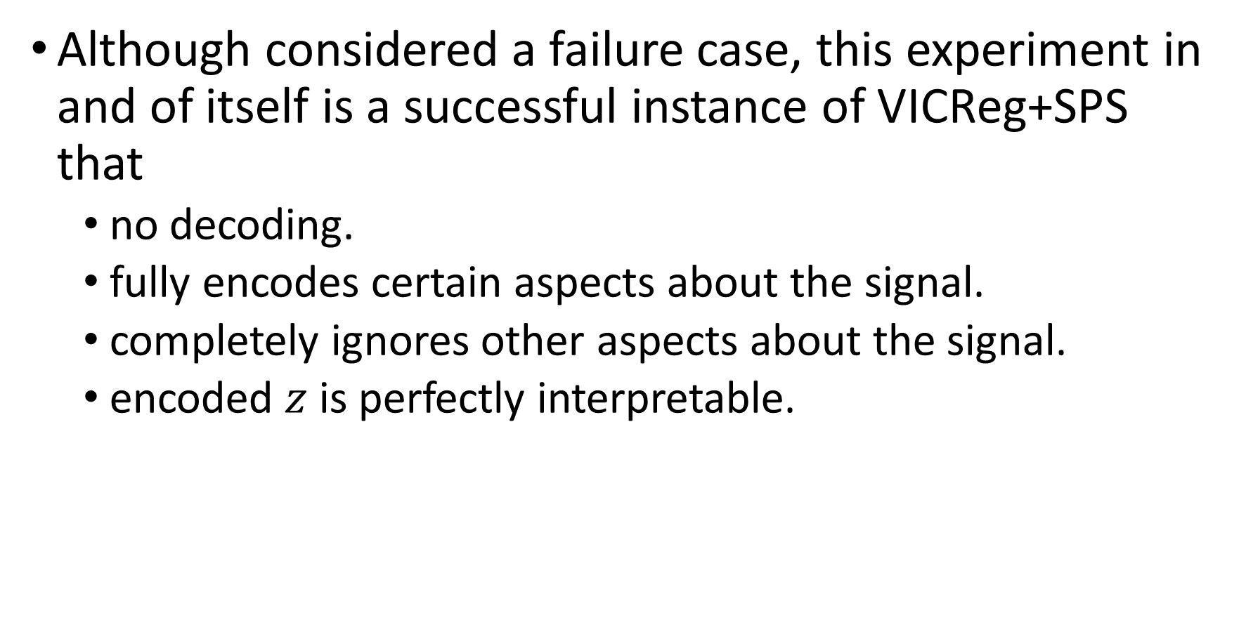
Although considered a failure case, this experiment in and of itself is a successful instance of VICReg+SPS that
no decoding.
fully encodes certain aspects about the signal.
completely ignores other aspects about the signal.
encoded $z$ is perfectly interpretable.

Slide 38
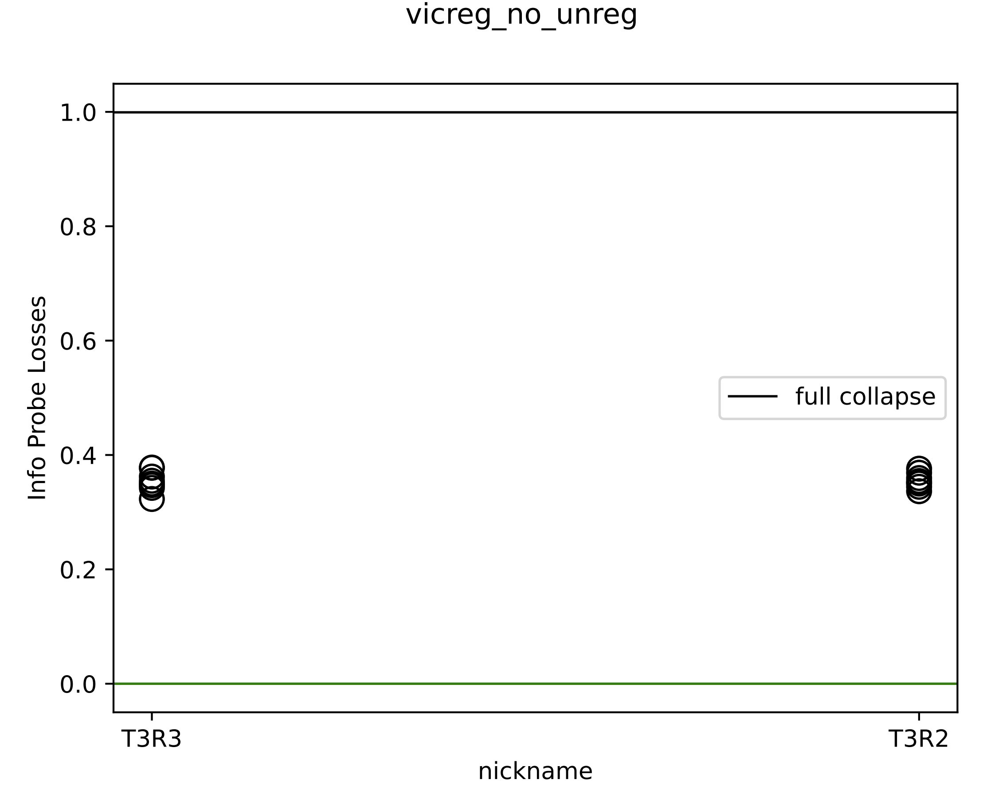
VICReg with ball height augmented
Invariance loss is higher.
RNN has trouble finding the ground just from video[:5].
Notes:
2023_m02_d02@02_53_43_vicreg_no_unreg

Slide 39
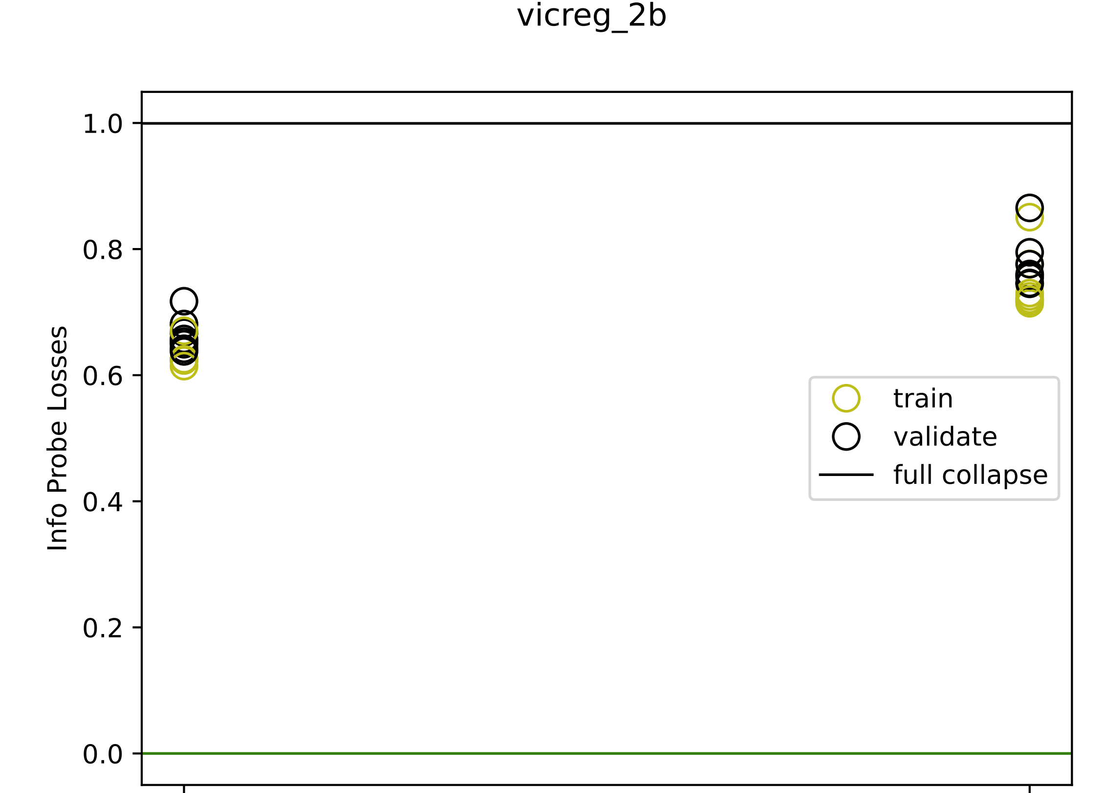
VICReg on 2Body
This raises doubts about the previous hypothesis.
Maybe 2D z worked like magic only because the covariance loss fully specifies mutual info up to zigzag.
symm
no symm
Notes:
2023_m02_d04@09_44_34_vicreg_2b

Slide 40
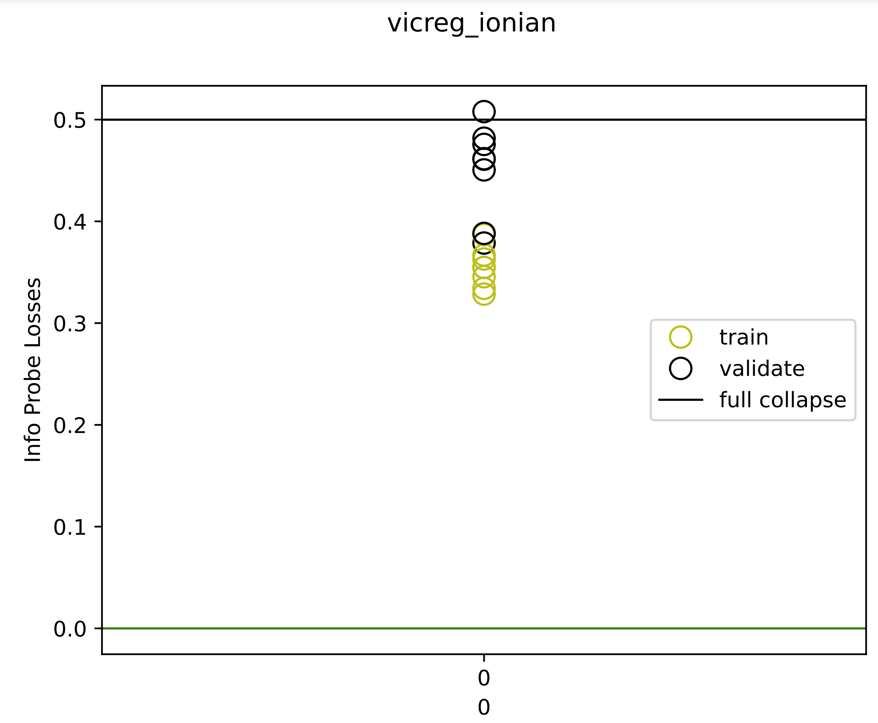
VICReg on Ionian scales
Notes:
2023_m02_d05@22_48_30_vicreg_ionian

Slide 41
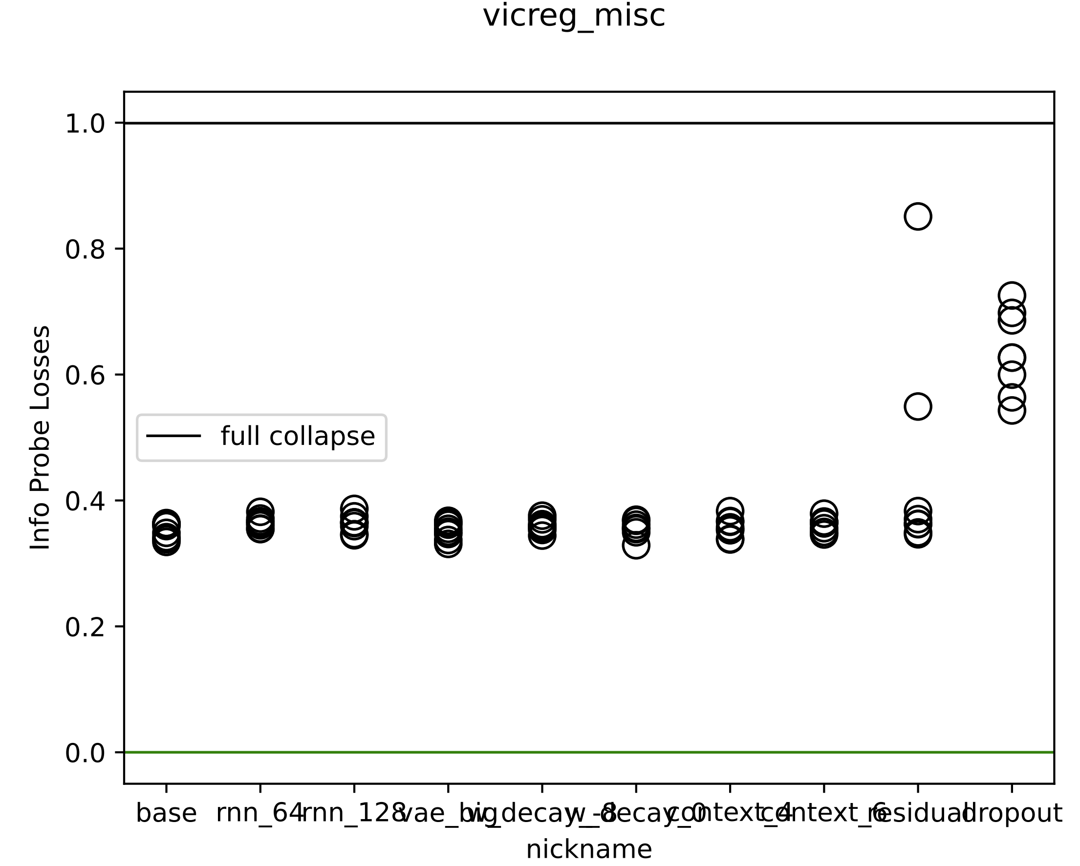
VICReg 接着调超参。结果：不调最好
Notes:
2023_m01_d30@01_03_57_vicreg_misc

Slide 42
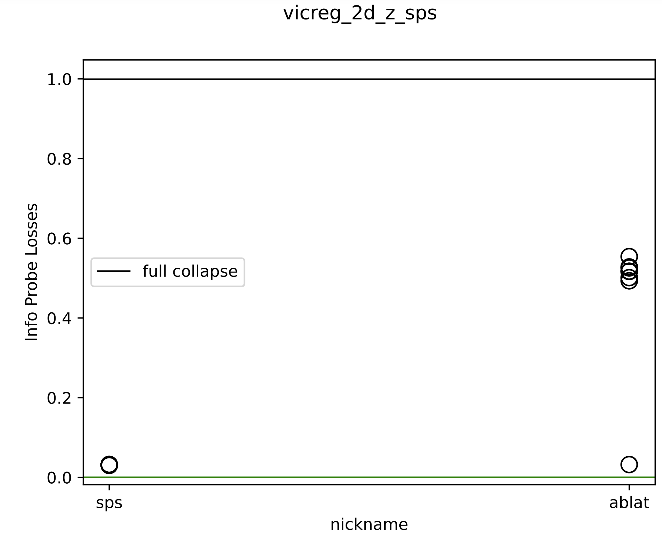
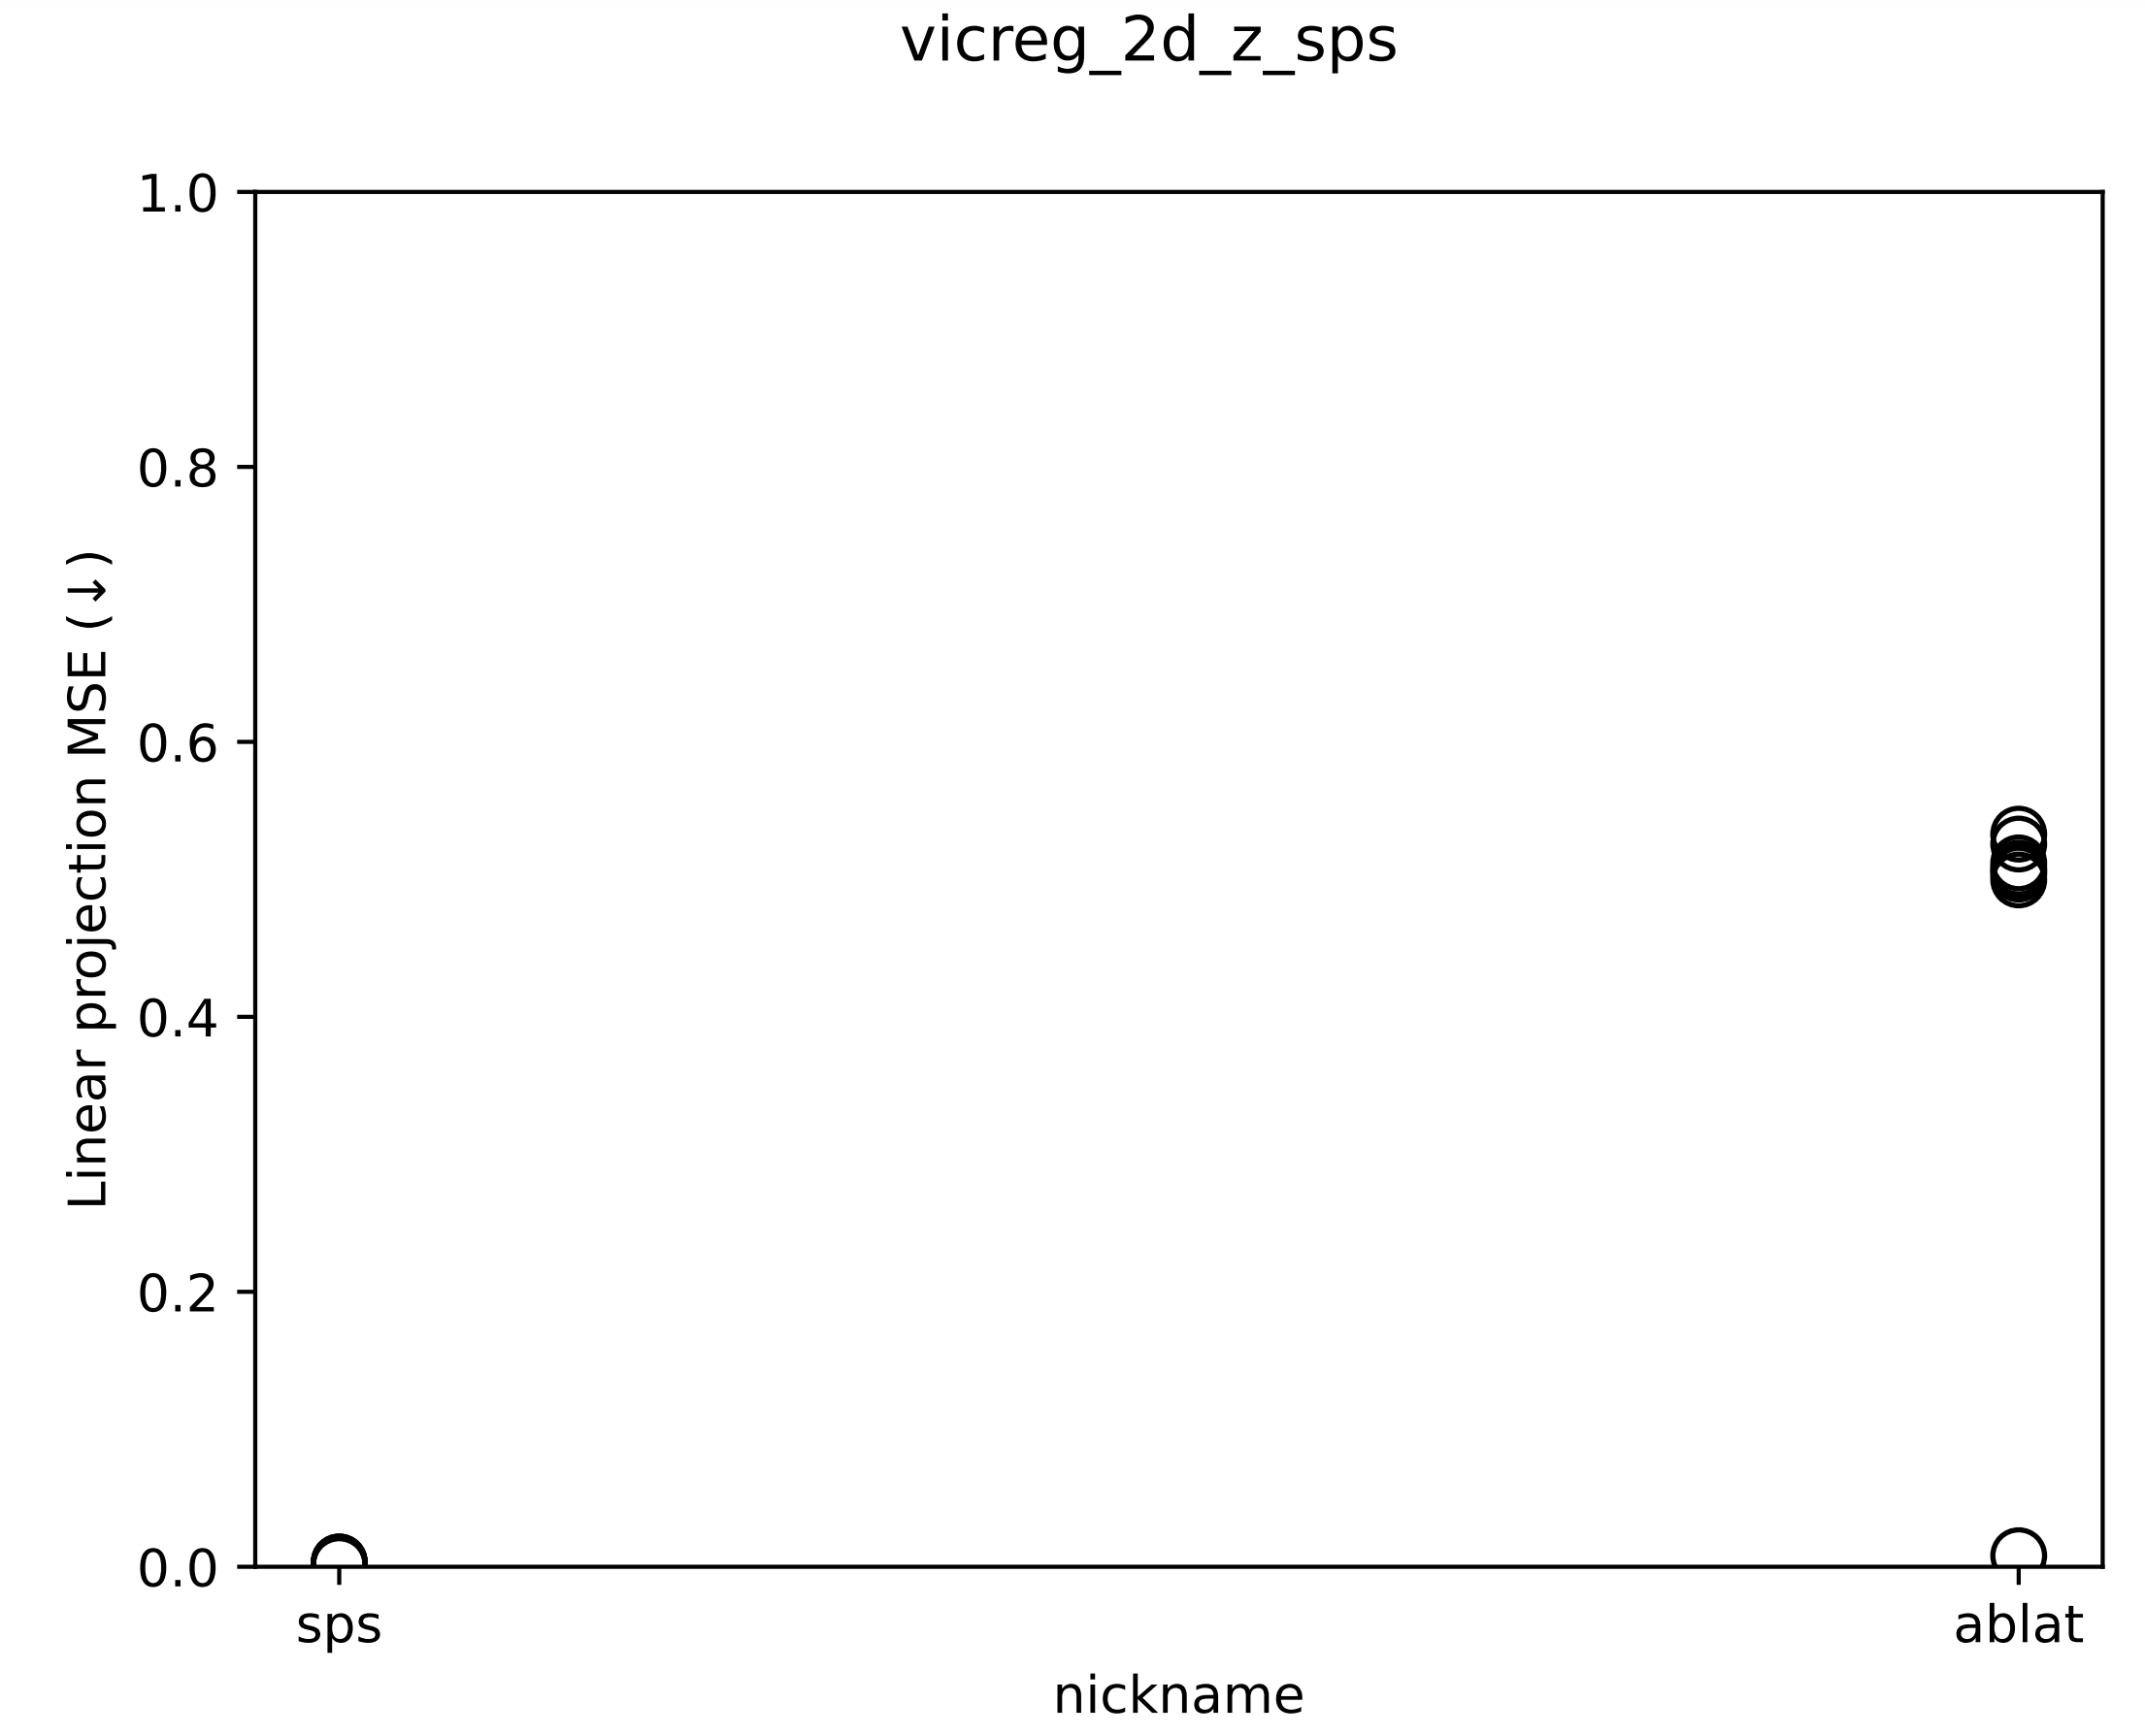
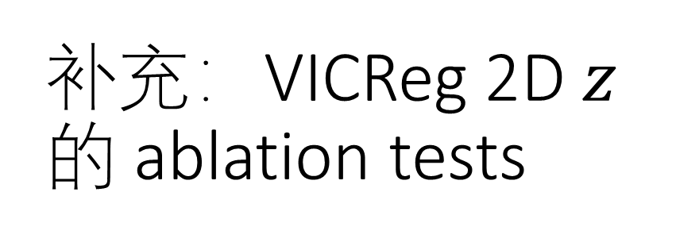
补充：VICReg 2D $z$ 的 ablation tests
Notes:
2023_m02_d02@02_53_43_vicreg_2d_z_sps

Slide 43
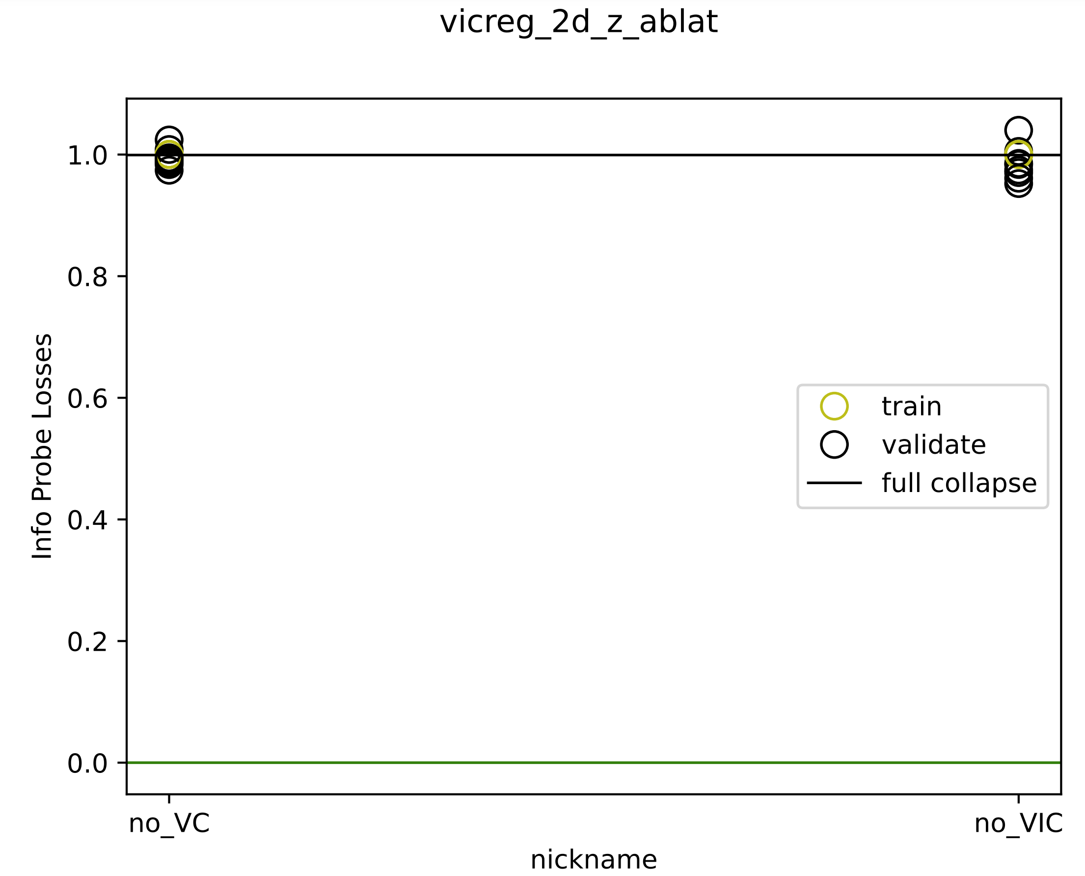
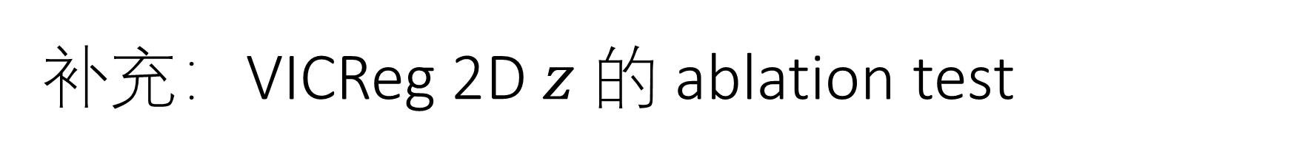
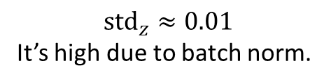
补充：VICReg 2D $z$ 的 ablation test
$${std}_{z}≈0.01$$
It’s high due to batch norm.
Notes:
2023_m02_d04@23_41_07_vicreg_2d_z_ablat

Slide 44
2Body

Slide 45
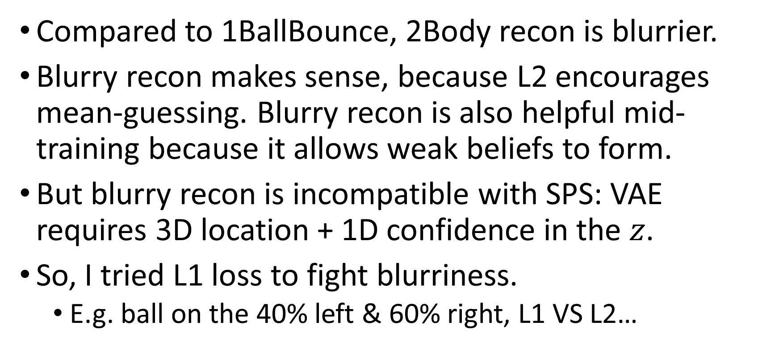
2Body L1 loss
Compared to 1BallBounce, 2Body recon is blurrier.
Blurry recon makes sense, because L2 encourages mean-guessing. Blurry recon is also helpful mid-training because it allows weak beliefs to form.
But blurry recon is incompatible with SPS: VAE requires 3D location + 1D confidence in the $z$.
So, I tried L1 loss to fight blurriness.
E.g. ball on the 40% left & 60% right, L1 VS L2…

Slide 46
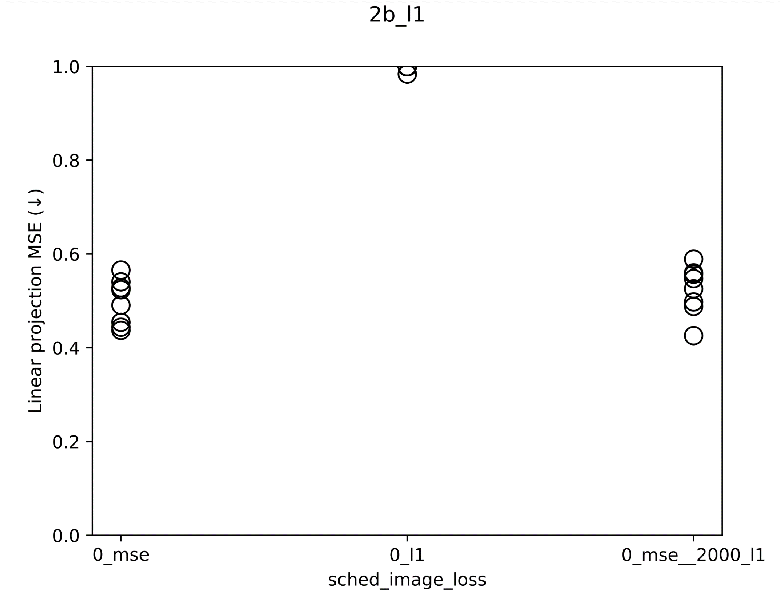

Slide 47
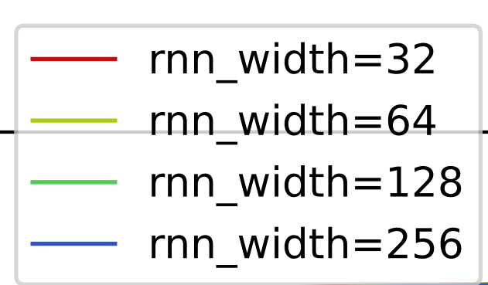

2Body: prediction is hard
2023_m01_d20@06_35_01_2b_rnn_width\rnn_width=128_rand_0\visualize_train_epoch_1000.mp4
And this is on the train set!
We tried but nothing helped. Image prediction loss is always high.

Slide 48

The linear proj. MSE went up after epoch 35K.
My theory:
When teacher forcing is high, clear images can be predicted.
When teacher forcing is low, a blurry image minimizes MSE, so VAE is forced to encode confidence into the 3D z, hurting interpretability.

Slide 49
Is the task too hard?
[take notes here]
Xuanjie recommended: try GRU.

Slide 50
有没有可能…
Judging form the video eval, I say the RNN 已经学会了规律，只是长程预测不准。
Its predictions look physically realistic to the eyes.
不如我们显式地建模 confidence, 把它从 z 里拿出来？

Slide 51

有没有可能…
Judging form the video eval, I say the RNN 已经学会了规律，只是长程预测不准。
Its predictions look physically realistic to the eyes.
不如我们显式地建模 confidence, 把它从 z 里拿出来？

Slide 52
双体：如何得到单球坐标？
My conclusion: we can’t. Unless we change the problem setting.
SSL + 4-shot calibration.
SPICE and Junyan’s metrical structure extractor both use 1 or 2 labeled samples to calibrate their unsupervised result.
2023_m01_d27@21_45_50_sps_2b
4-shot calibration is enough. 64-shot is better at reducing confounding / surface feature in 2Body.

Slide 53


Slide 54

SPS 倒是显著降低了 validate image pred loss...

Slide 55

Still, noSymm 好强
Something about our toy tasks is so trivial, even CNN inductive biases are enough.
Decoding has regularization effects.
3D 1Ball 弹跳，为何只需 $X−Y$ plane 的扩增？因为剩下一维高度受 decoding regularize.

Slide 56
Refactor: any-modal SPS
现在 video 和 music 共享 SPS 代码，只有 dataset 及其 metadata 不一样，作为参数传入。

Slide 57

SPS+decode on Ionian scales
All dims have translate aug.
Also, we see that z_dim = 1 cannot recon. Previously, I thought because the pitch aligns all partials the VAE would at least learn the pitch. Wrong.
Notes:
2023_m02_d04@21_07_57_ionian_z_dim

Slide 58

VRNN
No-VRNN: RNN models the VAE posterior mean.
VRNN: RNN models the VAE posterior sample.
The idea: 惩罚 RNN 关于输入的高频分量。
Notes:
2023_m01_d26@19_31_47_2b_vrnn

Slide 59

VRNN image pred 不牺牲？？

